Slide 1
Sicily: Southwest
Marsala
Castelvetrano
Campobello di Mazara
Mazara del Vallo

Slide 2
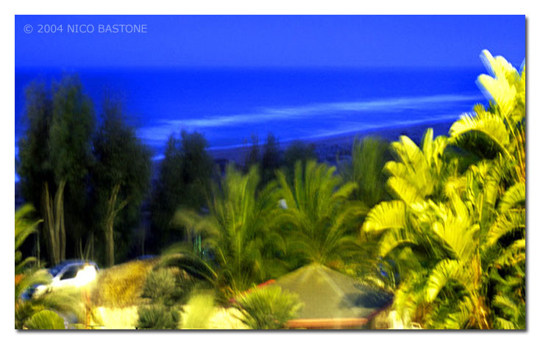
Vegetation of western Sicily

Slide 3
Marsala
Marsala's origins are very ancient. In the 8th c. BC the Phoenicians founded the city of Mozia (Motya) in the nearby Stagnone lagoon. Subsequently, refugees from Motya, fleeing from invasion and destruction by Dionysius I of Syracuse, founded Marsala. Probably already known as Lilybaeum it became an important Carthaginian military base, defended by an impressive boundary wall of which traces still remain. After falling under Roman domination (if not before, it was certainly now called Lilybaeum), it was the starting - point of the expedition against Carthage led by Scipio, later known as Africanus. The Romans were followed by the Vandals of Gaiseric and then the Byzantines. When it fell to the Muslirns they called it Marsa-Allah, Port of Allah.

Slide 4
History Continued
The town prospered considerably in the Middle Ages as an important centre of trade and commerce. The Normans took Marsala in 1072, rebuilt the castle and constructed churches and convents. A period of decline began towards the middle of the16th c., but the town, still fortified by its robust boundary wall, continued to be the headquarters of a military garrison and to play an important strategic role. In the 18th c. some enterprising Eng1ishmen set up the first establishment producing marsala wine, which was to have a considerable impact on the local economy.

Slide 5
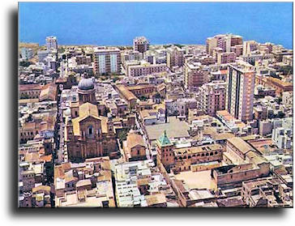

Slide 6
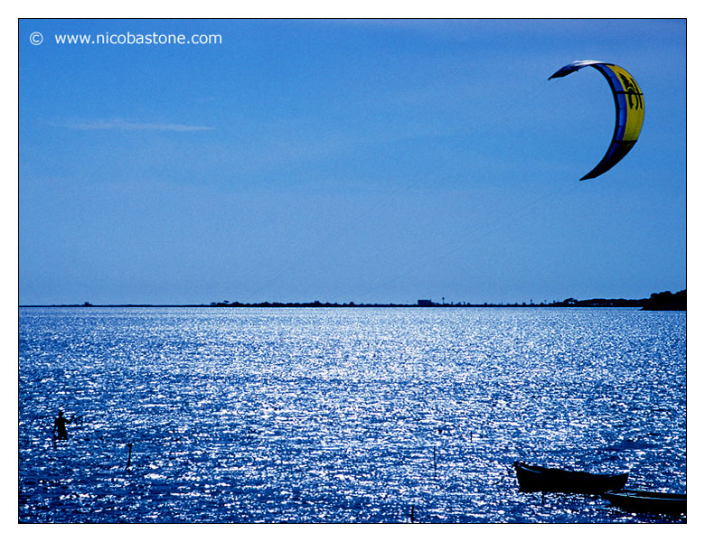
Marsala "Stagnone lagoon"

Slide 7
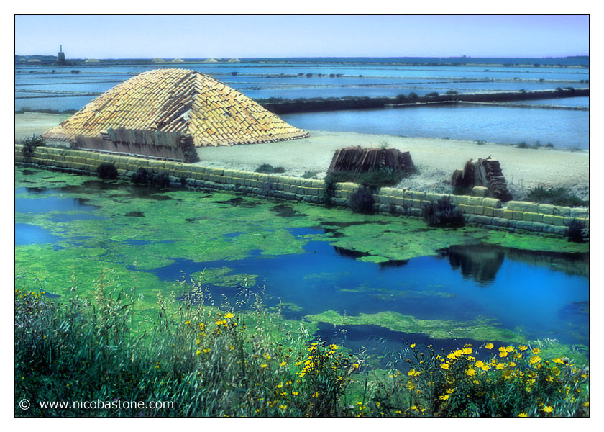
Marsala salt production

Slide 8
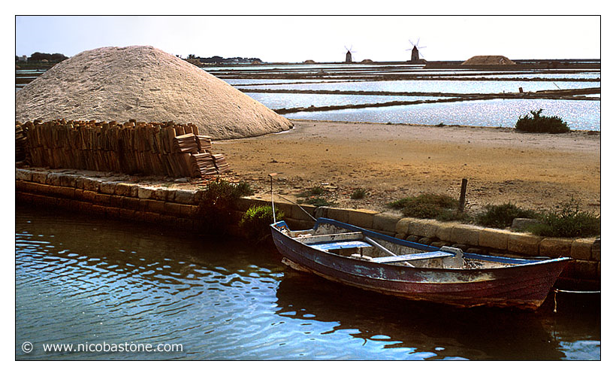

Slide 9
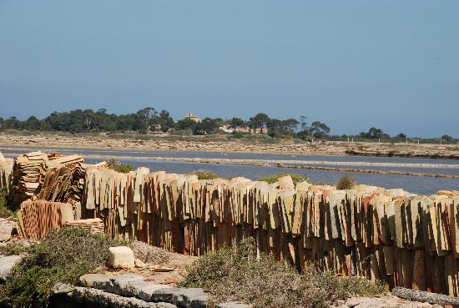

Slide 10
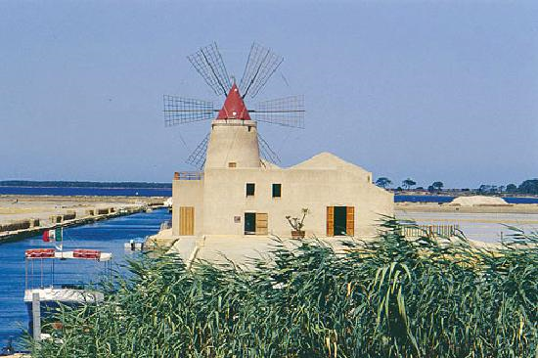

Slide 11
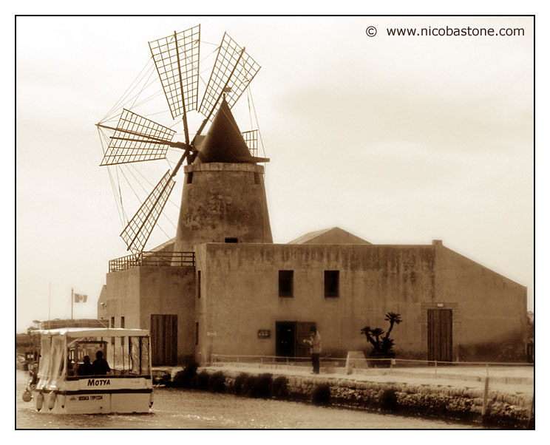

Slide 12
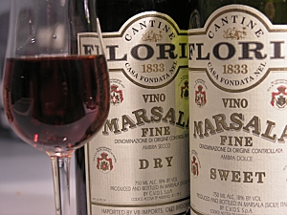
Also known for wine production

Slide 13
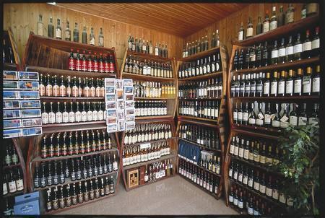

Slide 14
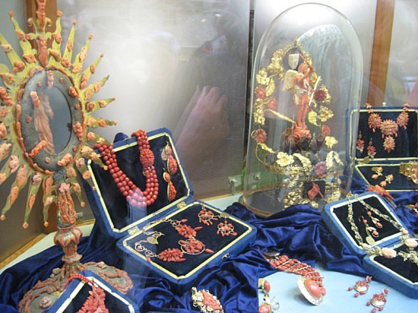
Coral Jewelry

Slide 15
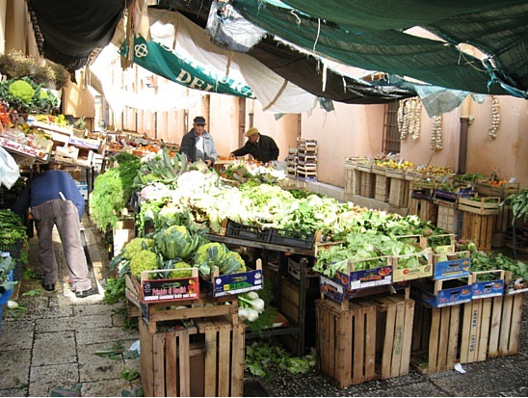
Farmer’s Market

Slide 16
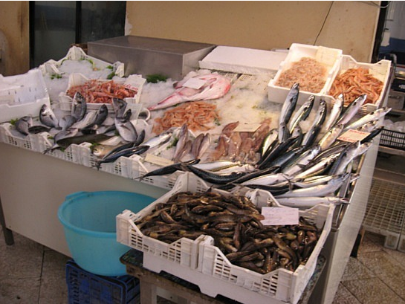
Fish Market

Slide 17
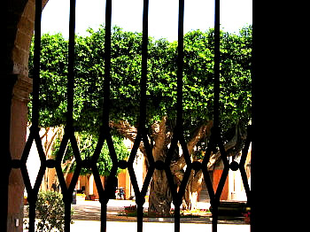
Old Olive Tree

Slide 18
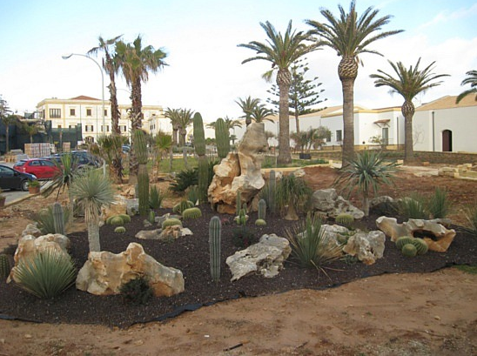
Mediterranean Vegetation

Slide 19
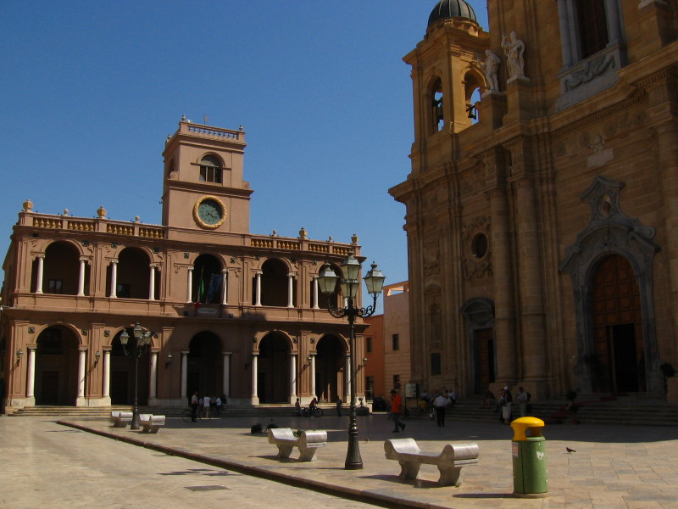
Main Square of Marsala

Slide 20
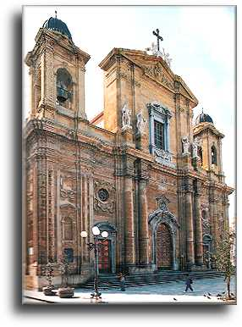

Slide 21
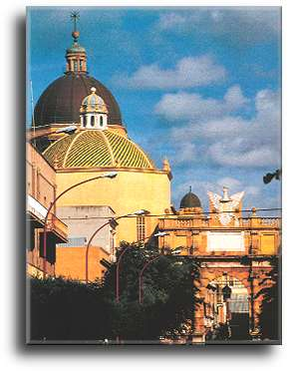

Slide 22
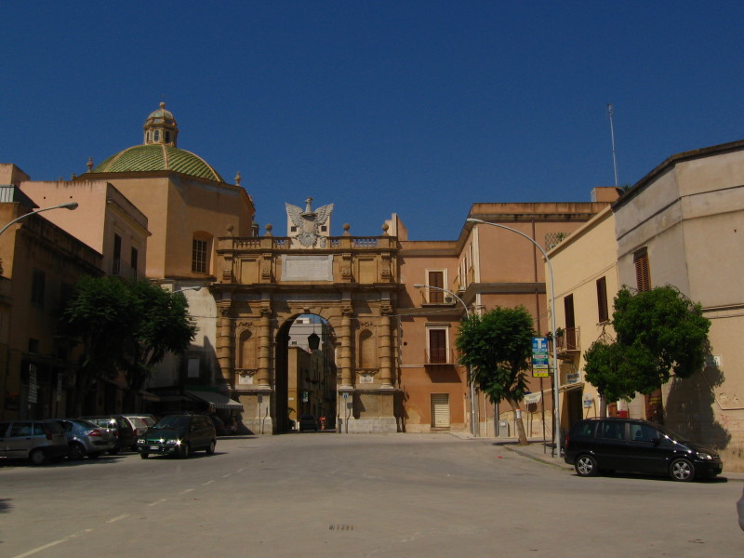

Slide 23
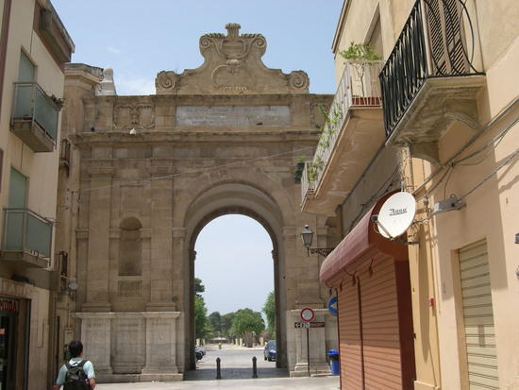

Slide 24
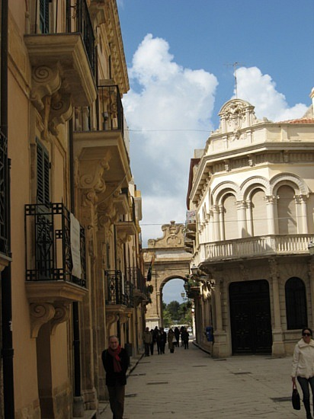

Slide 25
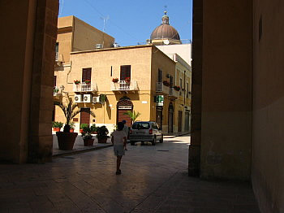

Slide 26
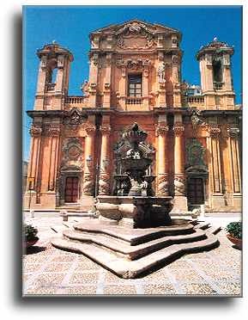

Slide 27
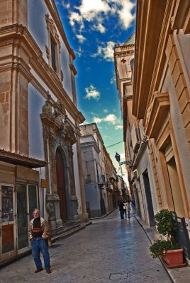
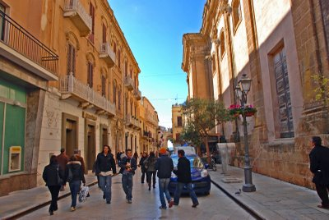
Street scenes

Slide 28
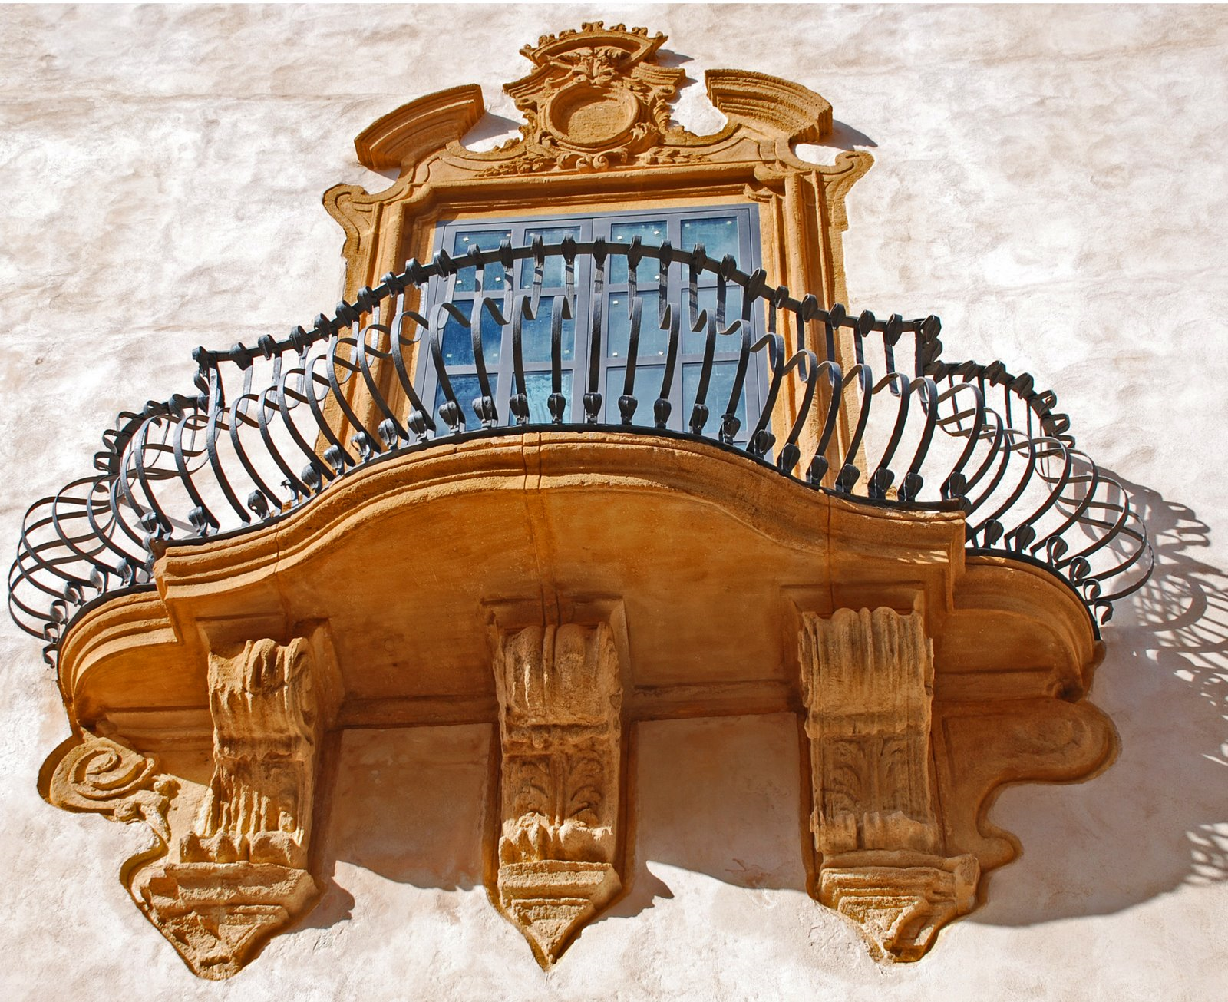
Ornate Balcony

Slide 29
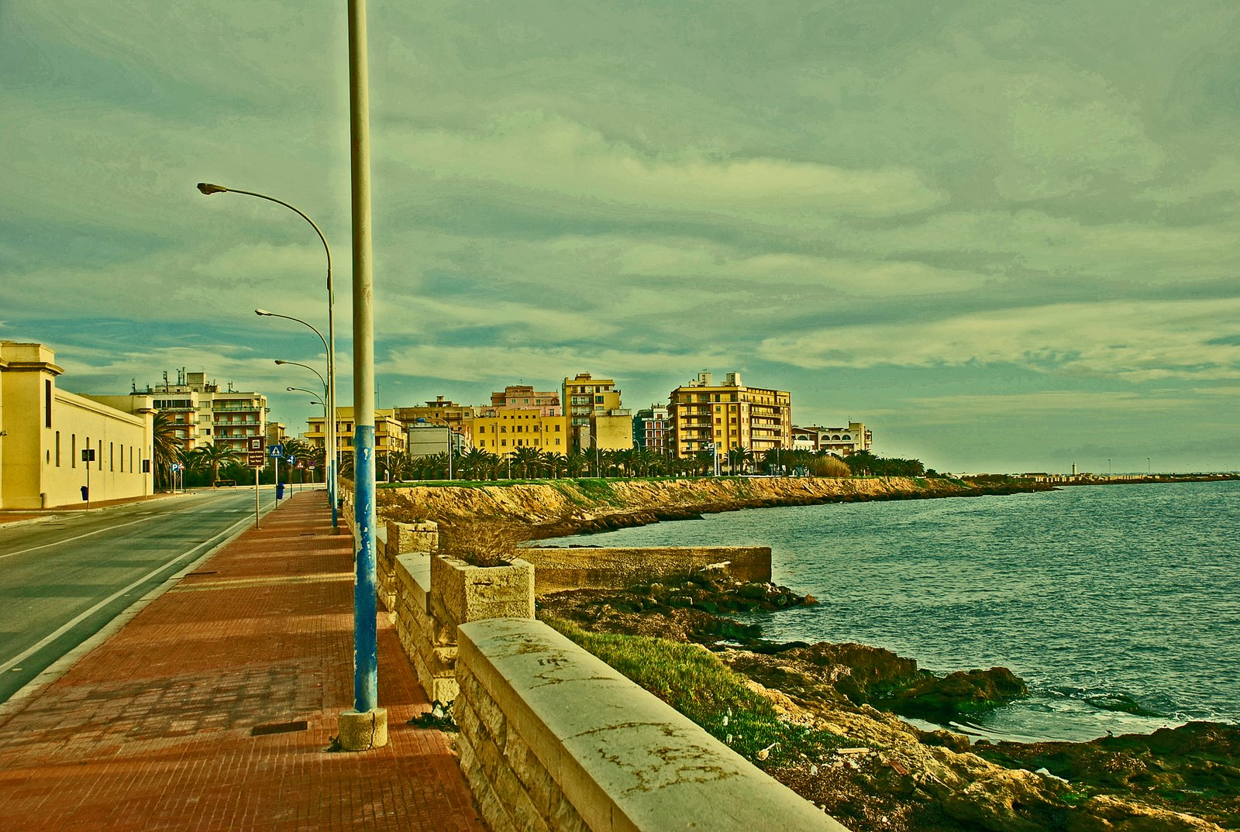
Promenade of Marsala, the closest point to Africa

Slide 30
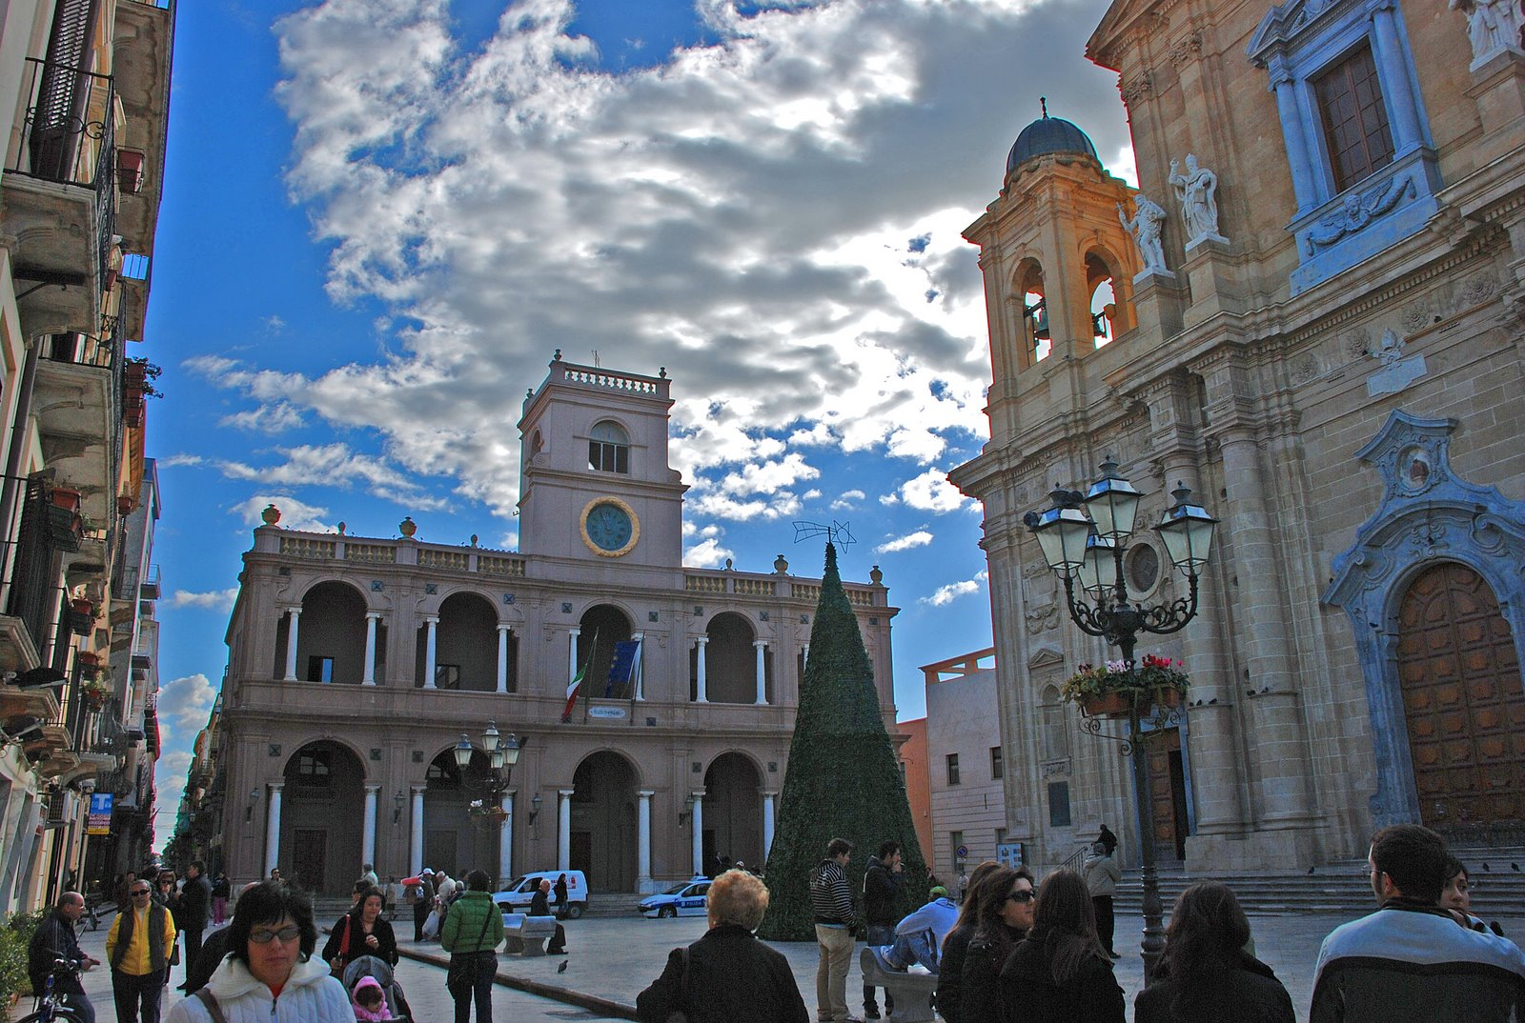
In front of St. Thomas, Marsala

Slide 31
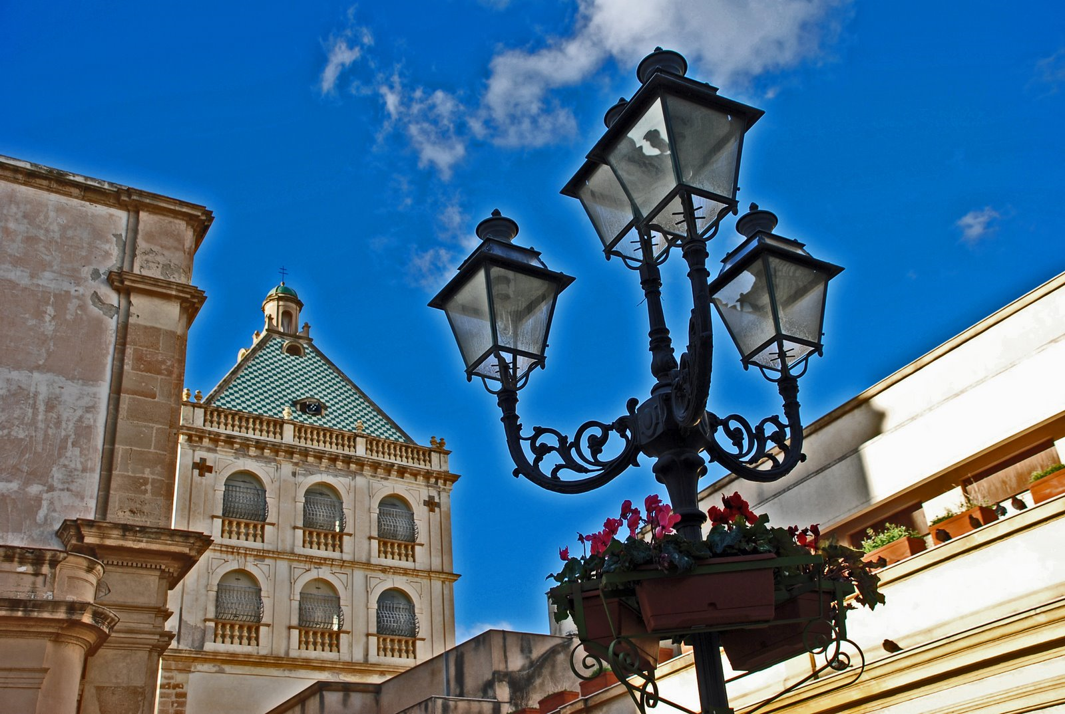

Slide 32
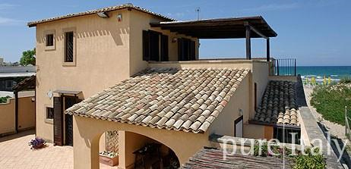
Mediterranean Villa at Marsala

Slide 33
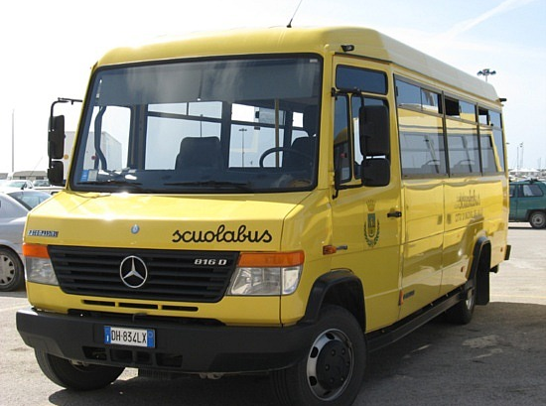

Slide 34
Castelvetrano
Its territory was inhabited before the foundation of the neighbouring Selinunte (7th c. BC), as testified by the ancient necropolis discovered in the modem town, in Piazza Umberto I. Castelvetrano later served Selinunte as a kind of suburb, or as a camp for the lodgings of veteran soldiers in charge of the stores, which were kept in great cistems. The name of the town apparently comes from castrum veteranorum, its original use. During the Roman and Byzantine period Castelvetrano followed the decadence of Selinunte, and under the Arabs it was reduced to a mere hamlet. In l299 it was made a fief of the Tagliavias, who promoted the development of the town. In 1653 the fief passed by succession to the Pignatelli Aragona family. In modern times the town' s buildings, agriculture, industry and commerce have developed considerably. Castelvetrano is still remembered also for the adventures of the bandit Salvatore Giuliano, which came to an end when he died here.

Slide 35
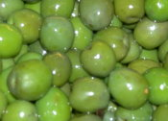
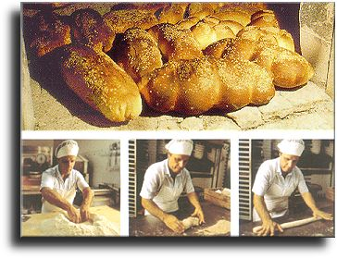
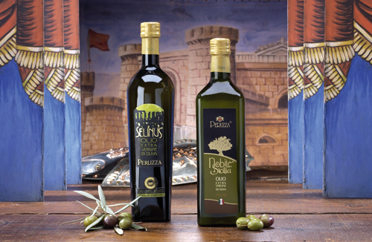
Famous for olives, olive oil, & bread

Slide 36
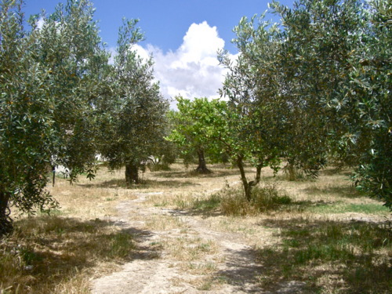
Olive Orchard
The Castelvetrano Olive, or Nocellara del Belice, is an olive grown in western Sicily with an intense green coloring and sweeter flavor.

Slide 37
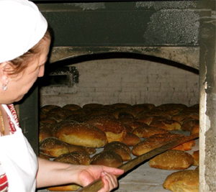
Traditional Bakery

Slide 38
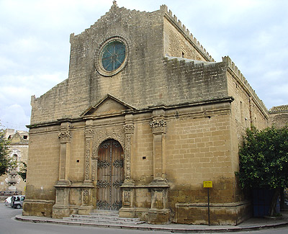
Duomo (Cathedral)

Slide 39
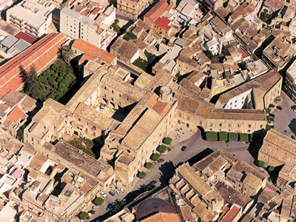
Aerial View

Slide 40
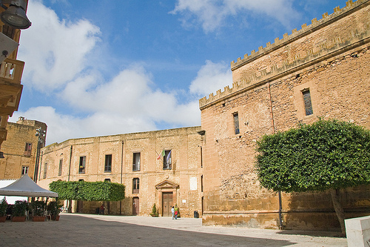

Slide 41
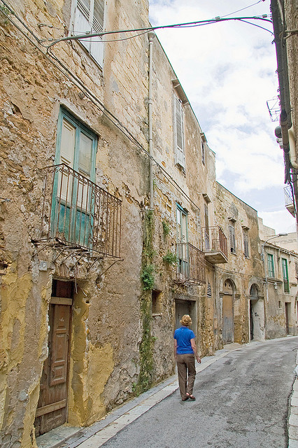
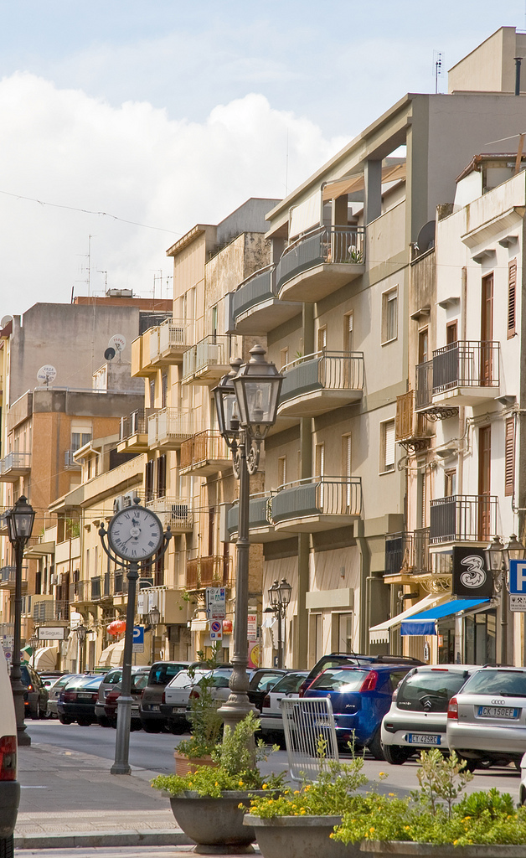
Back street in old city Commercial street

Slide 42
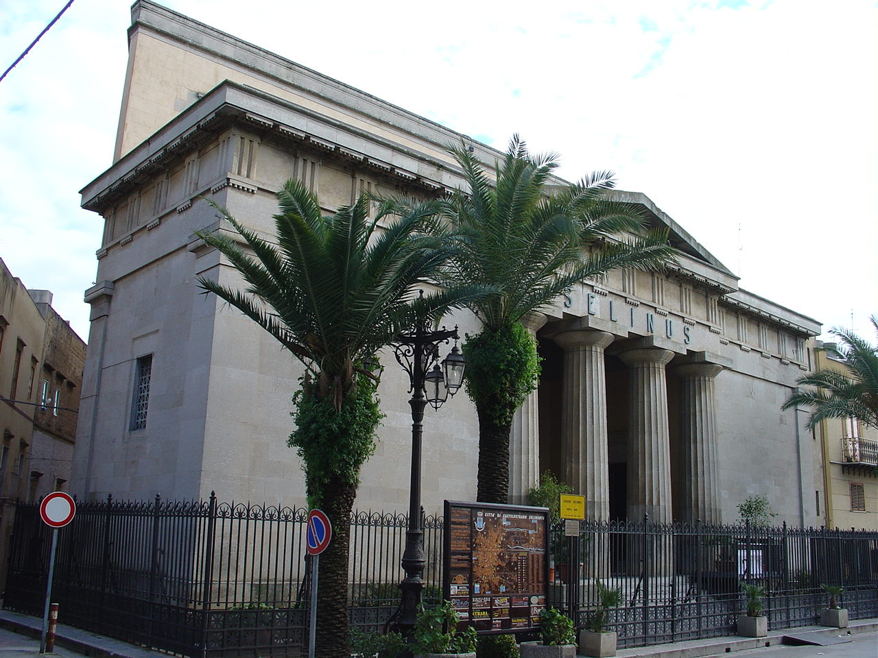
Selinus Theater

Slide 43
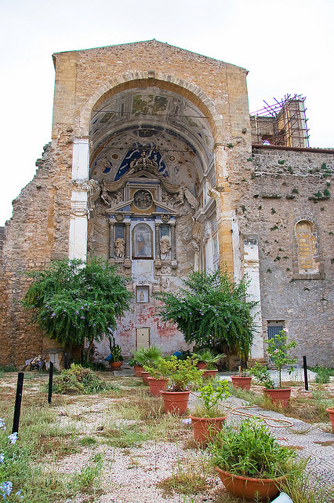
Ruins of a church

Slide 44
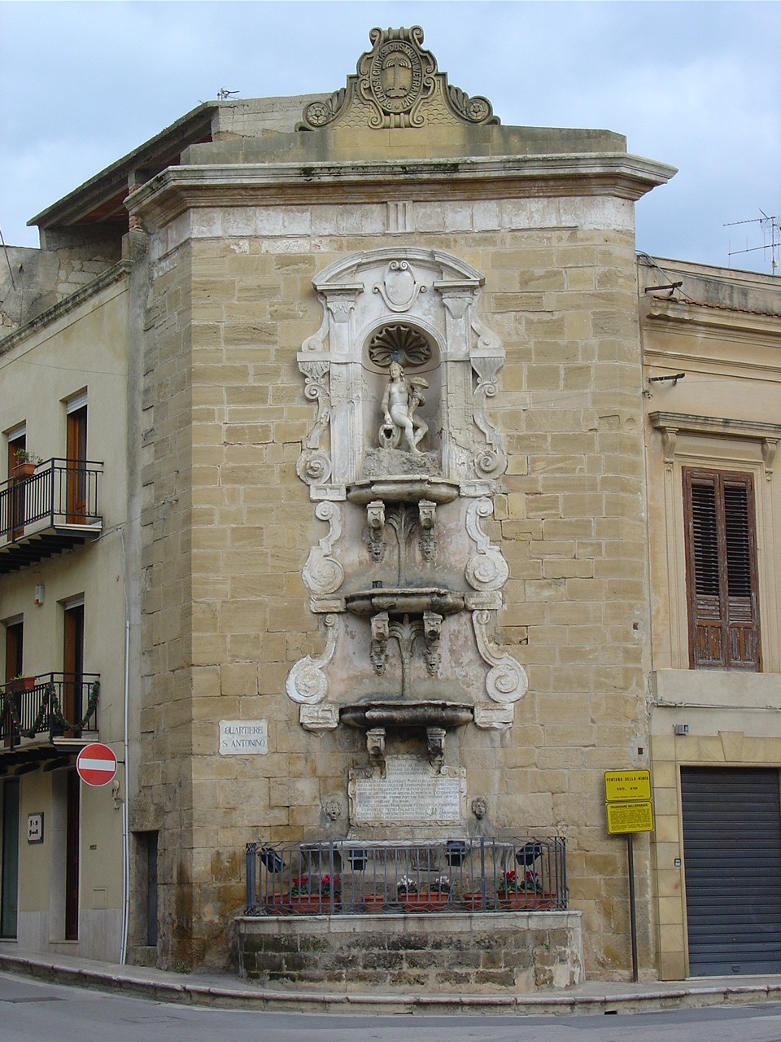
La fontana verticale di S. Ninfa a Castelvetrano

Slide 45
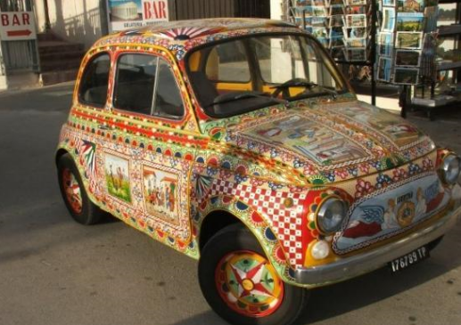
Colorful automobile

Slide 46
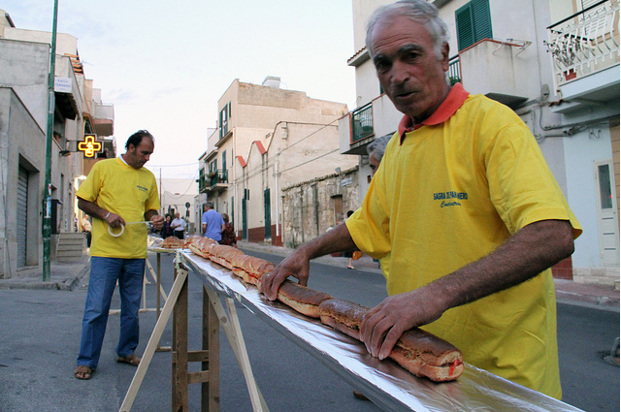
World’s longest sandwich

Slide 47
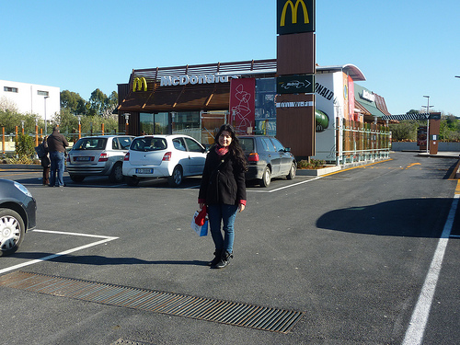
Globalization in Castelvetrano

Slide 48
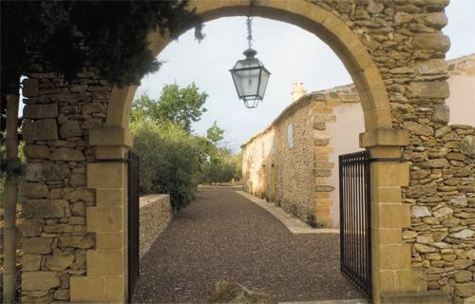
Entrance to a Villa

Slide 49
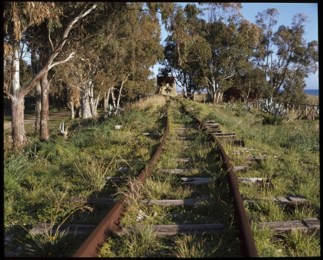
Castelvetrano to Porto railroad no longer in use

Slide 50
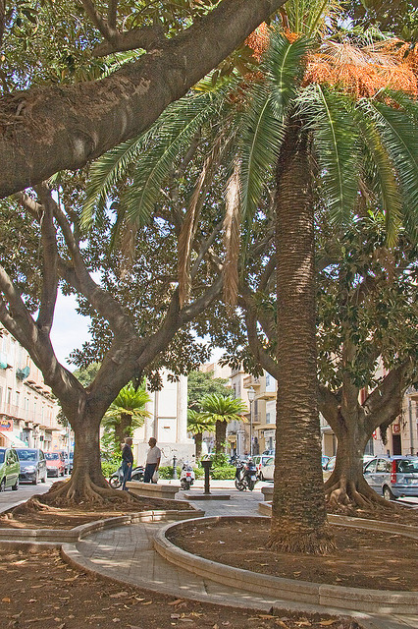
Palm trees & deciduous trees

Slide 51
Hibiscus

Slide 52
Mediterranean Vegetation (Maquis)

Slide 53
Sicilian robin

Slide 54
Wild flowers near Castelvetrano

Slide 55
Countryside near Castelvetrano (Hinterland)

Slide 56
Ruins of Selinunte near castelvetrano
Archaeological Park in the territory of Castelvetrano, 2 km from the sea, containing the ruins of Selinunte, the Greek colony founded by Megara Hyblaea, in 628 BC according to Thucydides, and in 650 BC according to Diodorus Siculus. The name of the city appears to be derived from a wild plant that grows locally, selinon, a kind of celery , or from the name of the nearby River Selinòs, now known as the Modione. The relationship between the autochthonous populations and the Greek settlers was anything but peaceful. Life at Selinunte, as amply testified in the ancient sources, was a series of conflicts and wars, particularly with its archenemy Segesta.

Slide 57
But Selinunte soon became rich and powerful, and in the 6th c. BC it was itself able to found a sub-colony, Heraclea Minoa, to the E, in the direction of Agrigento. This was the period of the establishment of tyranny, of the beginning of good cornrnercial relations with the Carthaginians, and of the creation of the urban structures, with the building of imposing works of architecture, such as the two temples on the acropolis, which the archaeologists, not knowing their original names, have called Temples C and D, while the one on the hill is known as TempIe F. The tyranny fell in the 5th c., but the pro - Carthage policy continued. This explains Selinunte's neutrality in the Graeco-Punic conflict, which came to its conclusion in the Battle of Himera in 480 BC. The passion for building that had characterized the tyranny once again began to be felt and Temples A and O were constructed, and the more prestigious areas were appropriately completed.

Slide 58
When the Peloponnese War shifted towards Sicily, Selinunte was involved side by side with Syracuse, but was unable to assist its ally because of the opposition of Agrigento and other cities fighting on the side of Athens. After the defeat of the Athenian army in Sicily, Selinunte was convinced that it could at last destroy its eternal rival Segesta, but it was stopped by the Carthaginians who, after a 9- day siege, conquered Selinunte and destroyed it (409 BC). The victors established a military garrison on the site of the ruins, and limited the town to the area of the ancient acropolis. In this area, the Punic city, as shown by numerous archaeological finds, survived until the mid- 3rd c. BC, when the territory passed under Roman domination.

Slide 67
2500 years old

Slide 70
MazaRA DEL VALLO
Because of its privileged position on the coast, Mazara has always been a seaport of great importanceand even today its fishing fleet is the biggest in Italy. It was initially a Phoenician port (6th-5th c. BC) allied with Selinunte. When Selinunte was destroyed by the Carthaginians Mazara was also seized. After the Second Punic war it passed to the Romans. It went through a period of decline, but began to prosper again after 827, when the Arabs first set foot on the island here at Mazara. The period of splendour continued throughout the successive Norman age, and Mazara was made the capital of the Val di Mazara.

Slide 73
Modern sculpture near the harbor

Slide 74
Roman Arch

Slide 76
Duomo

Slide 79
Rear of the Duomo

Slide 81
Upscale hotel

Slide 84
Piazza della Repubblica

Slide 85
La Piazza del Seminario

Slide 86
Church of Sant’ Vito

Slide 87
Madonna del Paradiso

Slide 88
Madonna del Paradiso interno

Slide 89
Sant’ Agostino

Slide 90
San Michele interno

Slide 95
Modern Hotel

Slide 97
Residential Area

Slide 99
Campobello di mazara
The town was founded in 1623 by Giuseppe di Napoli, who in 1630 was given a dukedom. Campobello di Mazara (Sicilian: Campubbeddu) is an Italian town in Sicily, part of the province of Trapani. Its inhabitants are scattered in the town center and the minor seaside frazioni of Tre Fontane and Torretta Granitola, populated mostly during the summer period. It borders on the neighbouring cities of Mazara del Vallo and Castelvetrano, and is colloquially known just as Campobello.

Slide 100
Cave (quarry) di Cusa near Campobello di Mazara

Slide 109
Via Roma

Slide 110
Chiesa Madre

