Slide 1
Vintage Vatican

Slide 2
Since 1929, Vatican City has been known as the world's smallest sovereign state -- covering only 110 acres of land -- and as the home of the Pope and the central administration of the Roman Catholic Church.

Slide 3
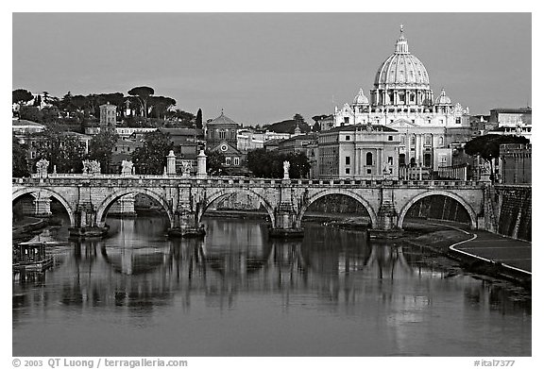
The Vatican viewed from Rome

Slide 4
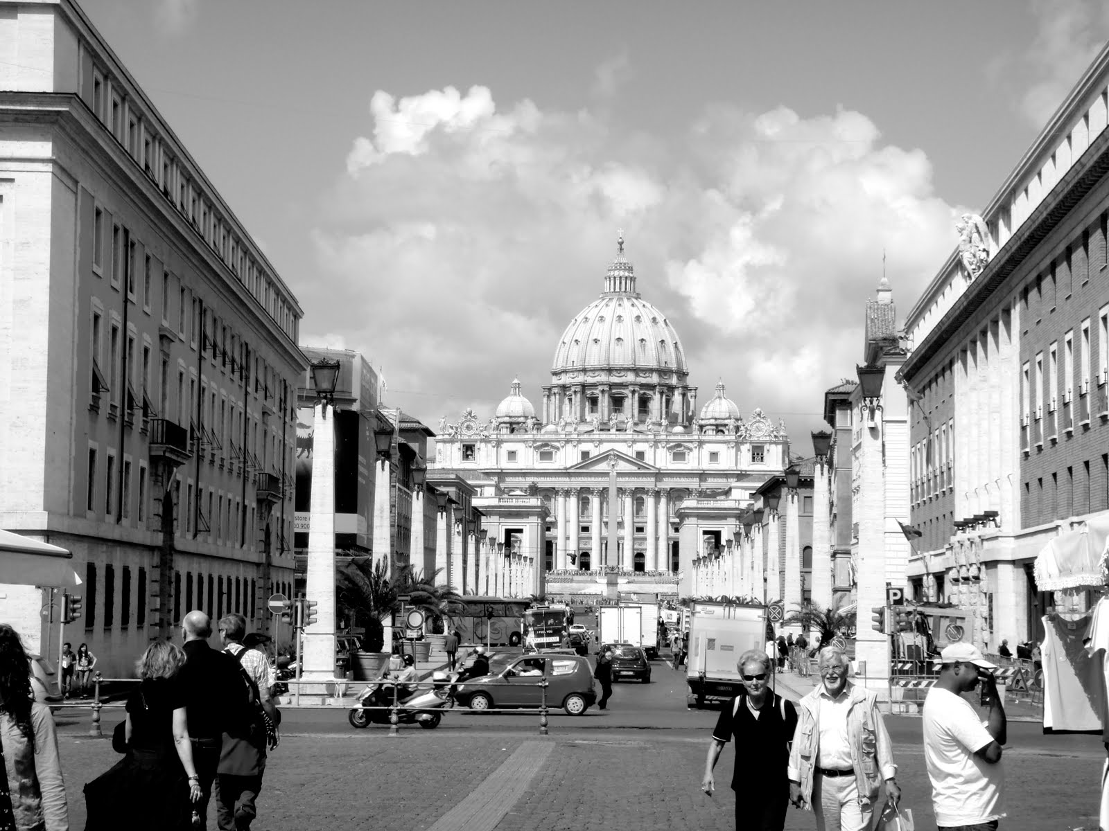

Slide 5
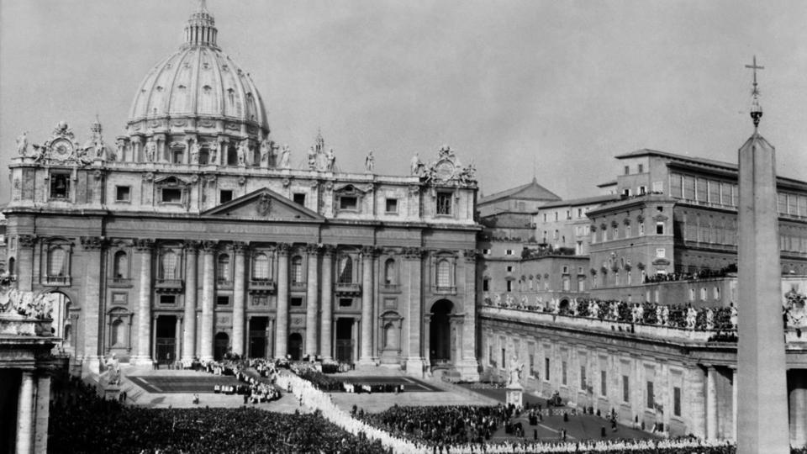
bishops hold a procession in front of St Peter’s Basilica in 1962.

Slide 6
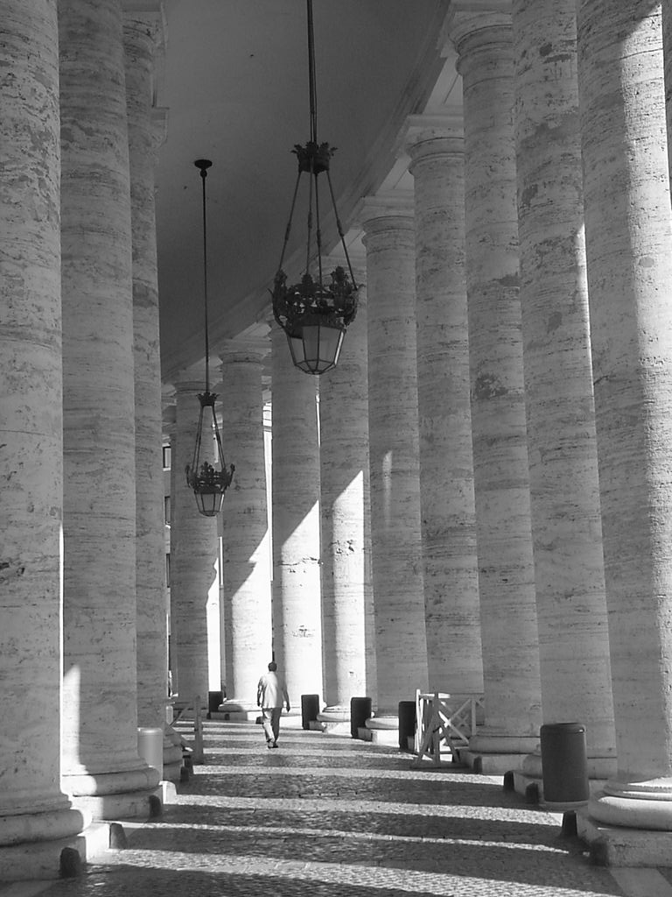
Colonnade

Slide 7
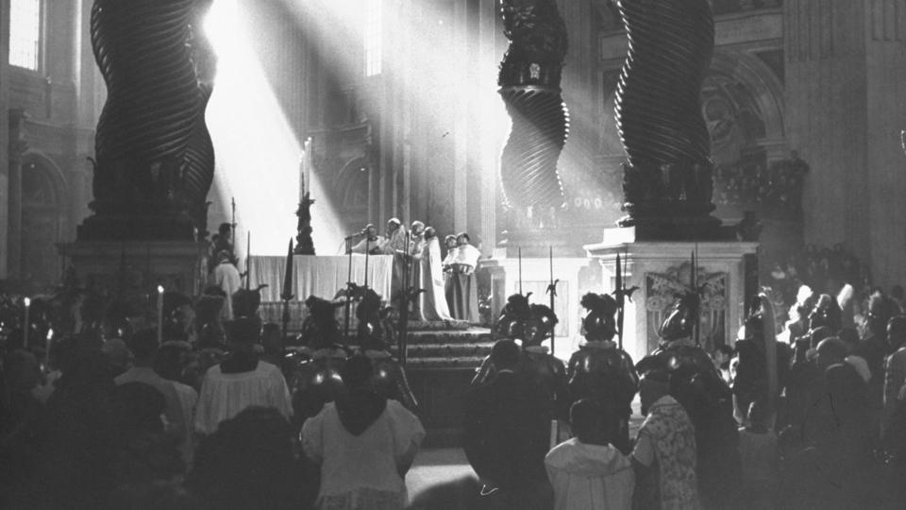
In 1949, Pope Pius XII listens as cardinals read terms of the papal indulgence at the altar of St Peter’s Basilica.

Slide 8
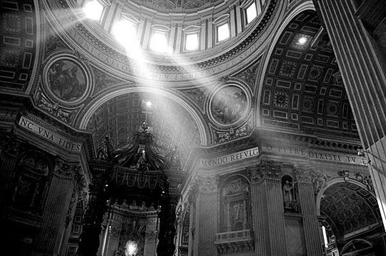

Slide 9
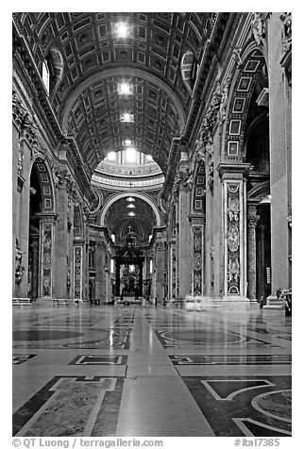
Inside Basilica San Pietro. Vatican City

Slide 10
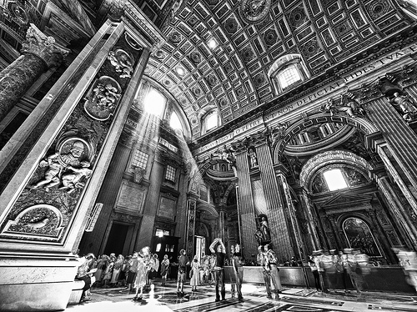

Slide 11
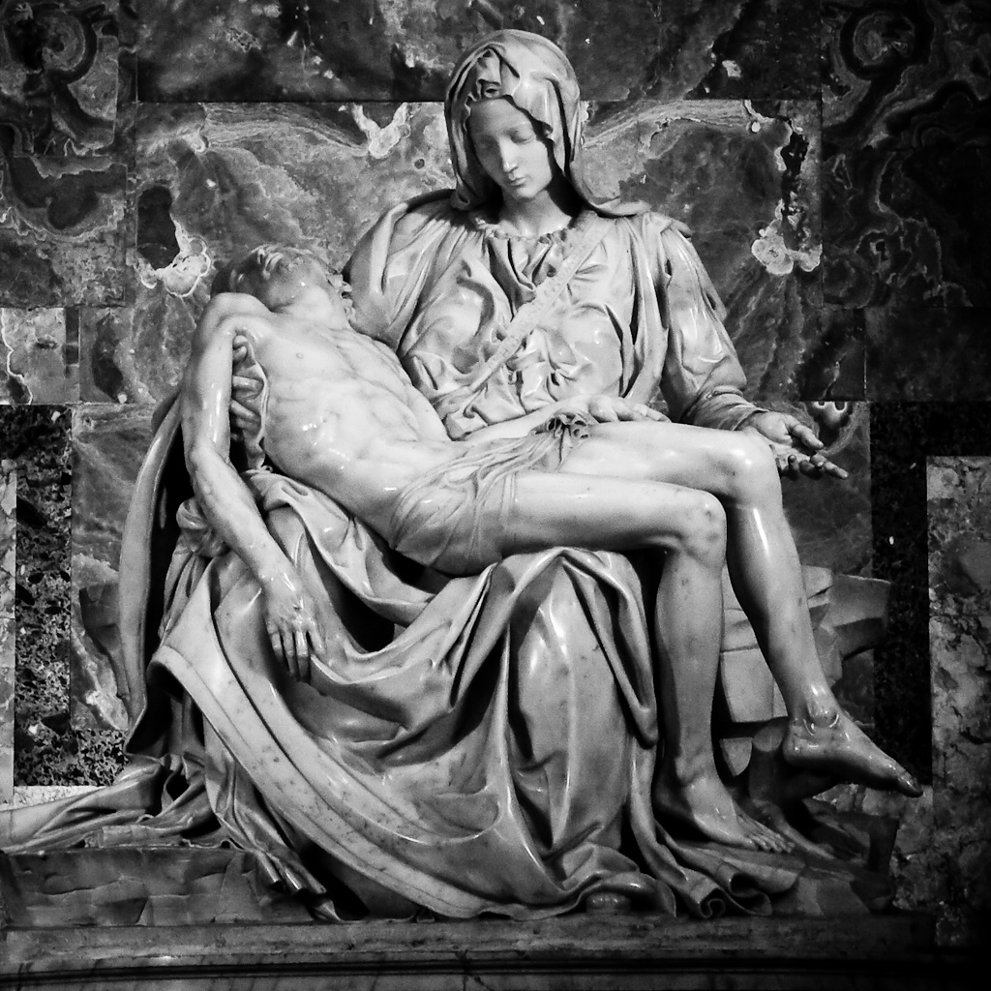

Slide 12
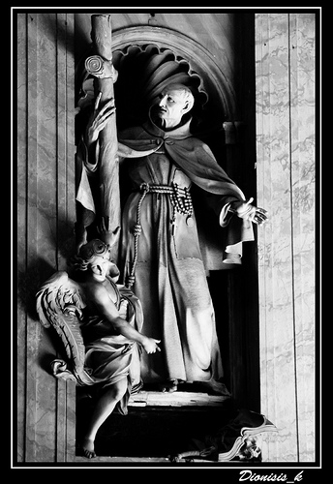

Slide 13
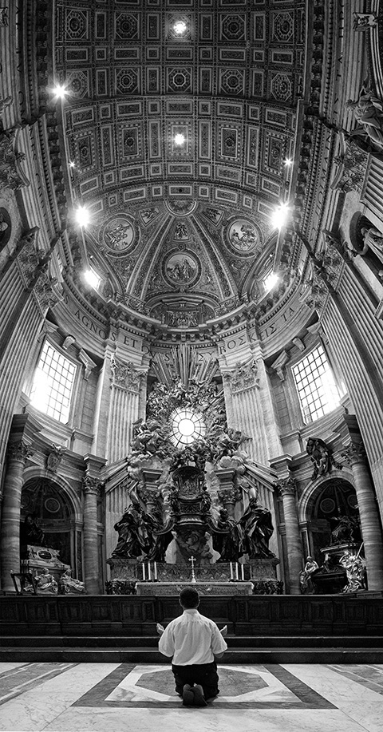

Slide 14
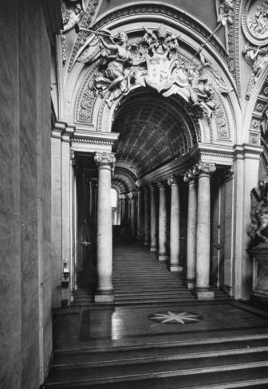
A marble statue of Emperor Constantine (barely visible at the right) stands at the foot of the Scala Regia staircase, which is part of the formal entrance to the Vatican and was designed by Giovanni Lorenzo Bernini.

Slide 15
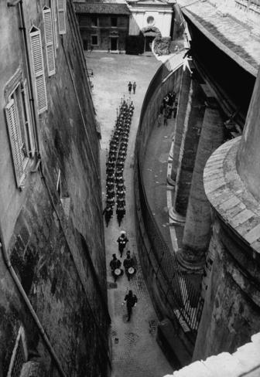
The Swiss guards are an international group of soldiers who have served the Pope since 1506, and provided security for various courts throughout Europe for centuries. The guards march through the Vatican during the 1954 canonization ceremonies for Pope Pius X, who served from 1903 to 1914.

Slide 16
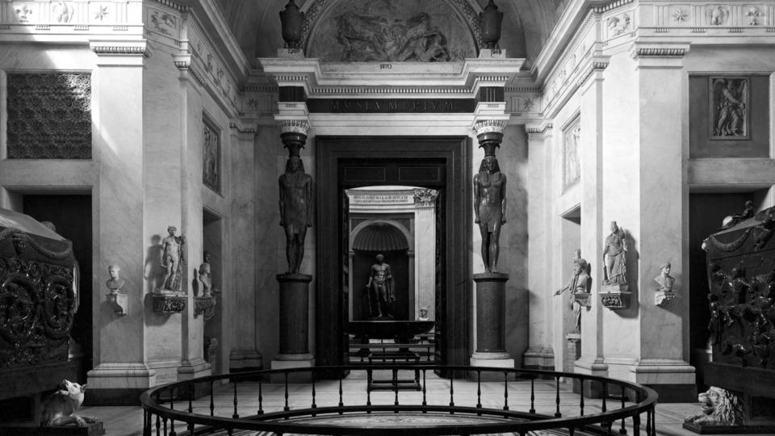
The Vatican began a formal museum in the 1700s to share the exquisite collection of art owned by the Catholic Church.

Slide 17
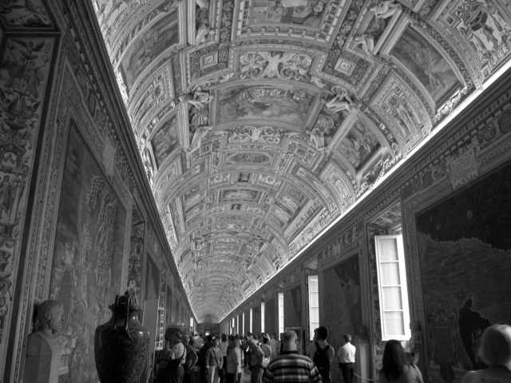

Slide 18
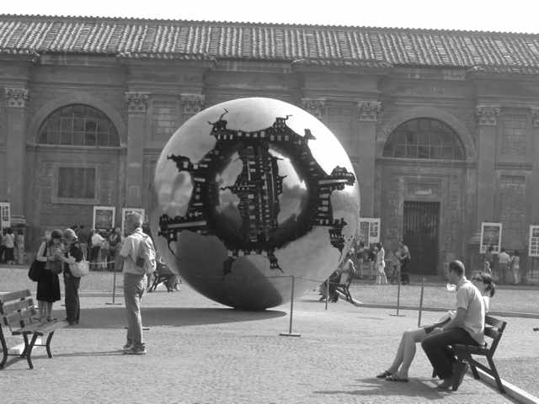

Slide 19
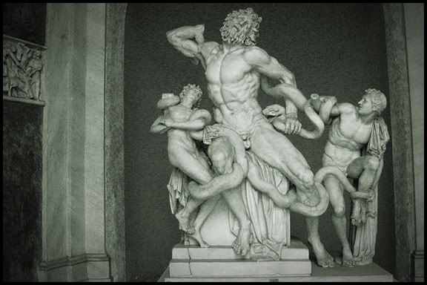

Slide 20
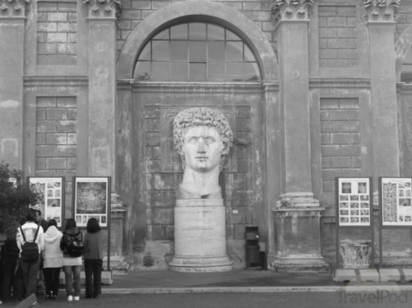

Slide 21
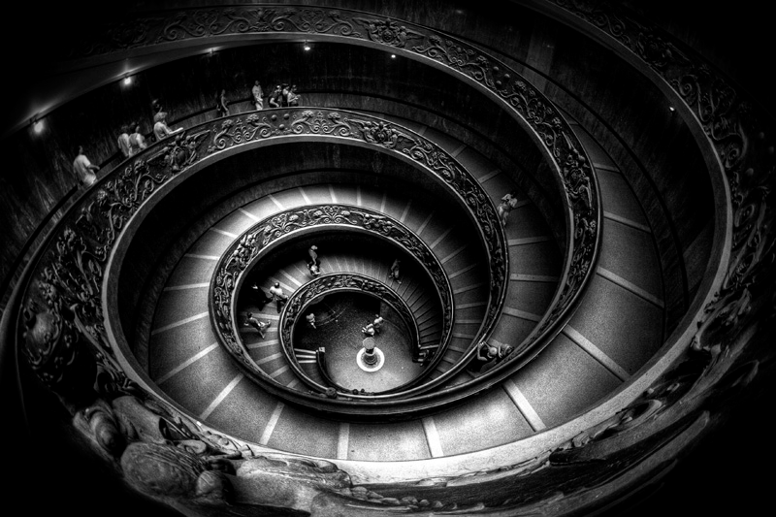
The double helix staircase at the Vatican Museum, designed by Giuseppe Momo in 1932 with a bronze balustrade which was sculpted by Antonio Maraini in a classical style.

Slide 22
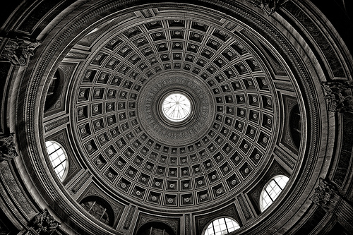
Cupola in Vatican Museum

