Slide 1
Project Management
April 2015
Understand Project Management principles

Slide 2
Introduction
Sharyn Lemmons, PMP
Senior Manager - Disaster Recovery Team
Express Scripts, Inc.
Gary Obernuefemann
Business Consultant IV
HP
Notes:
I am with HP Enterprise Services. We are a leading provider of IT services around the world.
HP is the world’s largest technology company. Currently, it brings together a portfolio that spans printing, personal computing, software, services and IT infrastructure to solve customer problems.
HP has over 300,000 employees world wide in over 170 countries.
Gary O. - I earned my undergraduate in 1982. I earned my MBA here at UMSL in ’88. I have been doing PM since 94.
Sharyn - I earned my undergraduate degree in 1986 and my masters in 1988 from Mizzou - both in Computer Science. I have been doing project management work since about 1991. I received my PMI Certification in 2003.
Eric - Graduated from UMSL in ’95 with a BSBA and an MIS emphasis … and never had Dr. Sauter. I have been doing PM since 1997. Earned my PMP certification in 2003.
Our opinions only. However, we developed our presentation based on our experience and utilizing the PMI (Project Management Institute) - PMBOK.

Slide 3
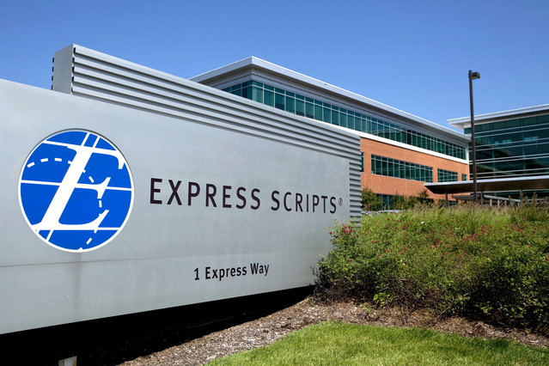
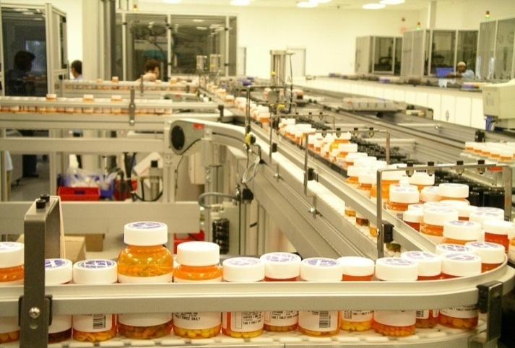
Making the Use of Prescription Drugs Safer and More Affordable
90 Million
members
1.4 Billion
prescriptions per year
3,500
clients
30,000
employees
National Leader in Pharmacy Benefits
Notes:
Express Scripts is one of the largest companies that many consumers don’t know – even though we process the prescriptions of one in three Americans, or roughly 100 million people. That’s because we’re largely a business-to-business operation.
We have more than 30,000 employees, and our corporate headquarters is in St. Louis, Missouri.
Our clients primarily are employers and government agencies who fund health care benefits, as well as labor unions. We also sell to Health Plans, who bundle the pharmacy and medical benefits together and offer them to employers and other payers.
Our mission is to make the use of prescription drugs safer and more affordable for everyone. And as the country’s leading Pharmacy Benefit Manager, we’re uniquely positioned to help.
At the most basic level, PBMs process prescriptions when they are presented to a pharmacy – our own, through mail-order; or at a retail location. We instantly verify coverage and co-pays, and run a series of safety checks to ensure patients are getting the right drugs, in the right dose, and without any potentially harmful interactions.
But Express Scripts is much more …

Slide 4
Top of Class Internship Program
Express Scripts Summer Internship Program
Networking
Development
Activities
Executive Speaker Series
Buddy Program
Professional Training
Real Work Experience
Formal Evaluations
Final Presentations
Internship Summit
Social Event
Volunteer Event
Spend your summer with Express Scripts!
Open internships can be found online at careers.express-scripts.com keyword search: Intern
Notes:
Express Scripts has a top of class internship program at very competitive wages.
Networking
Hear Sr. Staff members speak on the company, their growth as an individual and listen to advice to advance your career with Express Scripts.
Every intern is given a buddy to help acclimate them to our culture and environment.
Development
We offer professional training such as communication skills, executive presence, presentations skills and much more.
- Our interns are given real work experience and projects are utilized throughout the business.
Every intern will have two opportunities for evaluation on their progress and professional development goals.
All interns are required to give final presentations which are graded my members of management.
Activities
We have several activities throughout the summer including an internship Summit where all Interns attend a two day training, social event typically to a Cardinals game and a half day volunteer event.
There are still some openings left! Go to our career website to learn more!

Slide 5
Today’s Goal and Agenda
Present Project Management and discuss the relationship between Analysis and Design and Project Management
Notes:
Analysis and design are only two pieces in a process to create a successful piece of software.
One of the other pieces is project management. Our goal for today is to give you an appreciation for what project management is all about and how it relates to your project.
We want to help you understand the relationship between the planning you are used to doing in your head with the formal planning required in Project Management.

Slide 6
Your Turn
When someone says ‘project’ what comes to mind?
What is your class project assignment?
What is the hardest thing about your project?
What has been the biggest surprise so far about your project?

Slide 7
Project Definition
A project is a temporary endeavor undertaken to create a unique product or service.
Notes:
Building a building
Creating software
Running a campaign for political office
Starting a new business.

Slide 8
Project Characteristics
Performed by People
Constrained by Resources
Planned, Executed and Controlled
Temporary and Unique (as opposed to operations, which are ongoing and repetitive)

Slide 9
Successful Project
Meets or exceeds the customers requirements
Delivered on time
Within Budget
Notes:
The problem isn’t in the definition of ‘success’, it is in the definition of ‘failure’. If a project is 1 month late or 5% over budget, is that a failure or just disappointment?
Was HealthCare.Gov a complete failure (from a rollout, not a political perspective)?
According to the Standish Group, in their yearly 20010 CHAOS report on project management, found that 37% of all projects are successful (delivered on time, on budget, with required features and functions) , 42% were challenged (delivered late, over budget, and/or with less than the required features and functions), and 21% failed (cancelled prior to completion or delivered and never used). That means 63% of projects are ‘challenged’ in some way. Now Standish has a vested interest in reporting failures (because they sell a PM methodology) and others are debunking their definitions, data gathering/selecting techniques, and how they interpret the data but I won’t argue with their overall ranking numbers. A lot of projects have problems!!
Software Development Project Success Story from 2008: Functionality vs. Specs, Quality vs. On Time\Budget, Budget vs. ROI, Schedule vs. Ready.

Slide 10
Project Management
The application of knowledge, skills, tools, and techniques to project activities to deliver a successful project.
Notes:
Project Management is more like sailing a ship than baking a cake (predictive vs. adaptive).

Slide 11
Project Management Vs. Project Methodology
Methodologies give you templates of things to do
Project management applies them to this project
The approach\methodology can be Waterfall, or Iterative, or Agile or ??? But all need Project Management.
Notes:
What is needed for THIS project?
Does it save me time?
Is it a deliverable?
Does it contribute to the effectiveness of a later deliverable?
Good for people development?

Slide 12
5 Project Stages/Processes
Start Up / Initiating
Planning
Execution
Monitoring and Controlling
Close Down
Notes:
Start Up / Initiating - Scope and Procedures
Planning - Defining activities and assigning them to people.
Execution - Carry out the plan. The product is created here.
Monitoring and Controlling - Tracking, Tracking, Tracking.
Close Down - Discontinue operation of the project in an orderly, controlled manner. Reassign people, not fired!

Slide 13
Project to Development Relationship Model
Development Life Cycle
PM Stages / Processes
Start-Up / Initiating
Analysis
Planning
Design
Execution
Monitoring
Controlling
Construction
Close-Down
Notes:
On the left is what you have been studying.
On the right is how it maps to the PM stages.
Each stage is iterative so it gets confusing!

Slide 14
Roles of a Project Manager
Coordinator
Communicator
Leader
Negotiator
Planner
Notes:
Others!
Cheerleader
Confessor
Task Master
Protector
90% of PM is communications!!
Measurement!!!

Slide 15
Project Management Functions
Scope Management
Risk Management
Communications Management
Schedule Management
Human Resource Management
Quality Management
Cost Management
Procurement Management
Integration Management
Notes:
9 Project Management Functions
Scope - Shared expectations, Change Control, Making sure all required work, and only required work, is done.
Risk - Identification, Assessment, and Mitigation
Communication - Internal, External, When, Whom, What, How. Customer Relations
Schedule - On-Time. Proving it. Various calculations.
Human Resource - People
Quality - Plan for it. Be able to Prove it. Standards. Eyes of the beholder.
Cost - Budget vs. Actual. Various calculations.
Procurement – Subcontractor
Integration- Plan, Execute, Coordinate

Slide 16
Scope Management
Ensure that the project includes all the work required, and only the work required, to complete the project successfully.
Notes:
Project Scope is everything that goes into creating the product. What are you going to do and deliver (e.g., it includes testing, implementation, ...).
Requirements are what the user specifies as being needed. They can be functional, performance, quality, or process related.
No Gold Plating!!
No good deed goes unpunished.
What is the relationship between the requirements and the project scope?

Slide 17
Scope
Have you or can you develop a 3 Sentence Scope Statement for your project.
If not, what do you need to complete one?
Notes:
Do you have one? Do you know your scope?

Slide 18
Change Control
Ensure that changes are agreed upon.
Determine when scope change is desired/has occurred.
Managing the change through all other processes (schedule, cost, quality).
Notes:
Change in a project is inevitable and it is NOT bad. However, it must be managed!

Slide 19
Risk Management
The process of identifying, analyzing, and responding to project risk.
Risk is an uncertain event or condition that will have an effect on the project. It has a cause and an effect and a consequence to cost, schedule, or quality.
What is the biggest risk on your project?
Notes:
Identify
Analysis
Mitigation
Monitor and Control
Known vs. Unknown
Risk vs. Reward (fast schedule)
Not just CYA

Slide 20
Communications Management
Ensure the timely and appropriate generation, collection, dissemination, storage, and ultimate disposition of project information.
Who needs to know what? When do they need to know it? How will it be communicated and by Whom?
Notes:
Sending and Receiving Communication
Have to plan up front
Across all levels and organizations
Appropriateness!!!

Slide 21
Communications Management
What is your communication plan?
What is the Frequency/Method/Content of communication with
Dr. Sauter?
The Customer?
Each other?
Notes:
Who is responsible to make sure it gets done?

Slide 22
Schedule Management
Ensure the timely completion of the project.
Identify the specific activities that must be performed to meet deliverables.
Document dependencies
Estimate the time to complete an activity
Schedule development (start and end dates)
Schedule control
What is the Critical Path/Milestones for your class project?
Notes:
Know where you are at!
Know your critical path!
Some think this is Project Management. It is only one piece.

Slide 23
Schedule Management
When is your next deliverable due to Dr. Sauter? The customer?
When is your final delivery due to Dr. Sauter? The customer?
What is your critical path and who is on it?

Slide 24
Resource Management
Make the most effective use of the people involved in the project.
Planning
Acquisition
Development
Notes:
This involves sponsors, end users, suppliers, individual performers.

Slide 25
Quality Management
The processes required to ensure the project will satisfy the needs for which it was undertaken.
Identify what to measure
Periodically review the project
Monitor specific results to determine if they meet the relevant quality standards.
Notes:
Sox? Planned quality. Not Testing.
ISO9000
CMMI
Six Sigma
Walkthroughs
Sign offs
Coding Standards
Meeting Minutes

Slide 26
Cost Management
Ensure the project is completed within the approved budget
Notes:
Resources
Experience levels
Vacation, Sick, Quit
Equipment
Hardware, Software, Office Space, Copiers, Phones
Software licenses (for the customer or the project)
What you use
Cycles, Electricity, ...
Fixed Price, T&M, Fixed Resources
Define what is included and what isn’t.

Slide 27
Procurement Management
Acquire goods and services to attain project activities from outside the performing organization.
(aka Vendor Management, Subcontractor Management, Supplier Management)
Notes:
Getting more important!! This can be used to transfer or mitigate risk
Procurement Planning - what is needed when
Solicitation Planning - requirements
Solicitation
Selection
Administration
Closeout

Slide 28
Characteristics of Effective Project Management
Effectively plan the project
Accurately monitor and communicate the project progress
Ensure that all requirements are met
Ensure the project is on time and within budget
Schedule resources effectively
Manage changes to the project
Notes:
How

Slide 29
What does all this mean to you?
You know what you are supposed to be working on and when it is due
You know what is going on in the project
You know how to communicate your status
You know the critical path items and the critical success factors for the project.

Slide 30
Benefits
Projects delivered on time and within budget that meet customers expectations.
No more death marches
Success can be duplicated. Failures can be learned from.
Return business

Slide 31
INF SYS 6847 : FINANCIAL AND PROJECT MANAGEMENT
Prerequisite: IS 5800 Management Information Systems
Effective project management ensures that a project is completed on time, within budget, and has high quality. The purpose of this class is to examine the task of project resource management with a focus on IT and services. It will cover conventional aspects of project management, such as the project evaluation, planning, roles, responsibilities, scheduling, and tracking. In addition, this class will examine risk management, change management, critical chain management, build vs. buy analysis, package vs. custom solutions, vendor qualification and selection, and the roles of certification in the process. The class will also cover the management of programs or a portfolio of IT projects.

Slide 32
To be successful in PM ...
Using a methodology and working with the customer, develop a plan and execute it with defined tools and procedures.
Piece of cake! ☺
Notes:
Stamp out unsuccessful projects!!

Slide 33
Questions/Comments?

