Slide 1
Business Analytics for the 21st Century
Trends and Hot topics

Slide 2
Agenda
Introduction
The BI Job Market
Analytics People & Processes
Data Science Roles
Analytics Products & Services
Analytical Platforms
Analytics & Ethics
Privacy by Design
March 9, 2015

Slide 3
A Brief Overview of Data Mining
http://www.thearling.com/
Innovation | Business Question | Technologies
Data Collection (1960’s) | “What was total revenue in the past 5 years?” | Mainframe computers, tape backup
Data Access (1980’s) | “What were unit sales in New England last March?” | RDBMS, SQL, ODBC
Data Warehousing (1990’s) | ““What were unit sales in New England last March? Drill down to Boston” | OLAP, multi-dimensional databases, data warehouses
Data Mining (Today) | “What’s likely to happen to Boston sales next month and why?” | Advanced algorithms, massively parallel databases, Big Data
While technical capabilities have changed, the analytic process is relatively similar

Slide 4
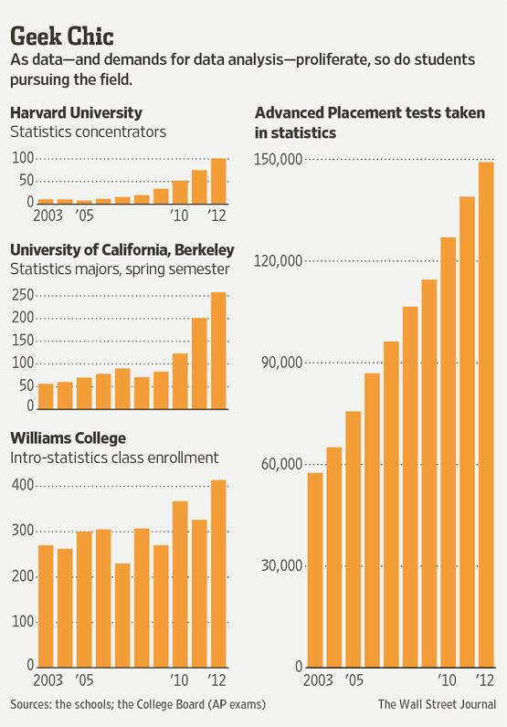
Business Analytics In Demand
Data Scientist
Deemed “the sexiest job of the 21st century” by Harvard Business Review, data scientists bridge the gap between the skills of a statistician, a computer scientist and an MBA.
Salaries vary from $110,000 to $140,000

Slide 5
Data Mining Job Prospects
Gartner says worldwide IT spending will increase 3.8 percent in 2013 to reach $3.7 trillion, and that excitement for big data is leading the way.
By 2015, 4.4 million jobs will be created to support big data.
Over 90-percent of the NCSU Class of 2013 have received one or more offers of employment, and over 80-percent have accepted new positions. The average base salary reached an all-time high of $96,900, an increase of nearly 9% over the Class of 2012.

Slide 6
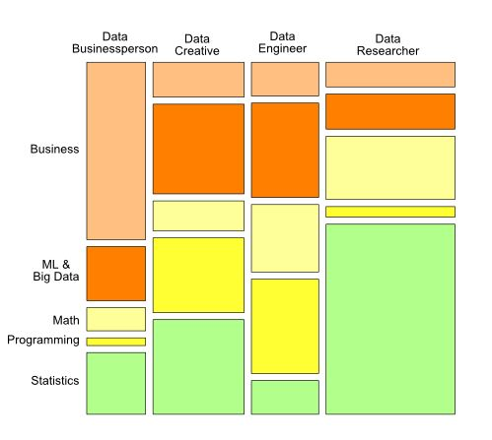
Harlan Harris:
The Data Scientist Mashup
Data Scientists blend 3 core skills in a surprising number of ways:
Coding
Machine Learning (math)
Domain Knowledge

Slide 7
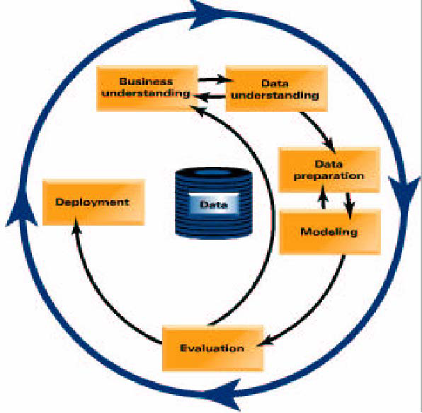
CRISP-DM: Data Mining Methodology
Up to 60% of the work effort in a major data mining project is typically related to data preparation and cleansing
Be prepared for the unexpected when working with real-world data
ftp://ftp.software.ibm.com/software/.../Modeler/.../CRISP-DM...

Slide 8
Business Analytics & Data Mining Services
Descriptive
Dashboards
Process mining
Text mining
Business performance management
Benchmarking
Predictive
Predictive analytics
Prescriptive analytics
Realtime scoring
Online analytical processing
Ranking algorithms
Optimization engines
These functions are highly inter-related and fall on a continuum
March 9, 2015

Slide 9
Data Scientists Work in Teams
Job Categories
Business Analyst
Data Analyst
Data Engineer
Data Scientist
Marketing
Sales
Statistician
Many major organizations in St. Louis are actively using data mining in their core line of business
http://www.datasciencecentral.com/

Slide 10
Statistical Business Analyst

Slide 11
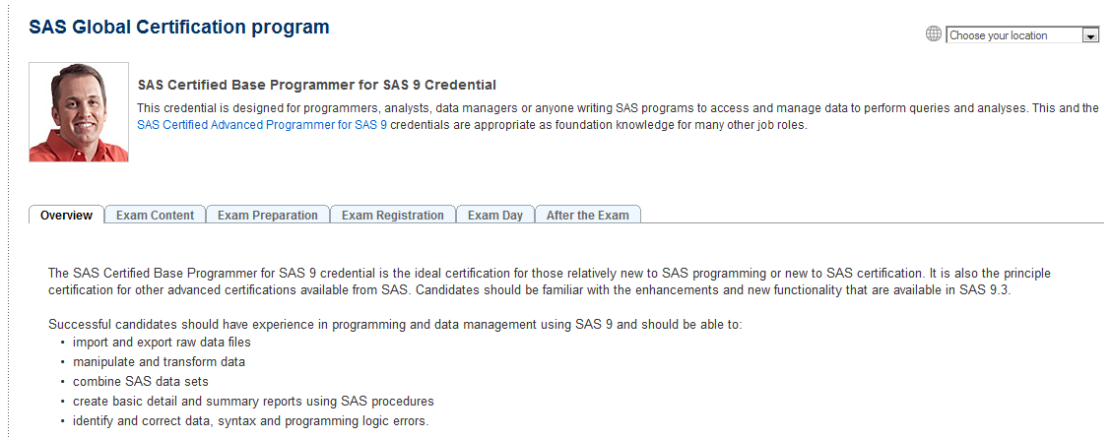
Statistical Programmer

Slide 12
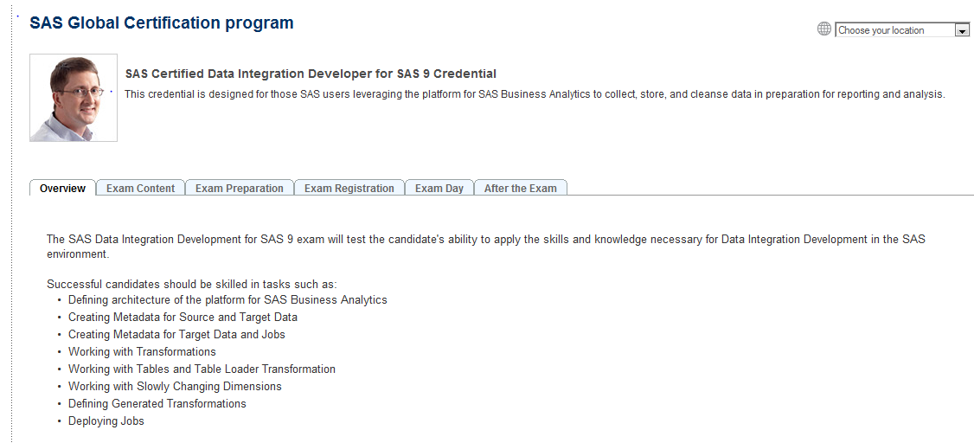
Data Integration Developer

Slide 13
Predictive Modeler

Slide 14
A Typical Product Developer / Data Scientist Role
Job Details
Facebook is seeking a Data Scientist to join our Data Science team. Individuals in this role are expected to be comfortable working as a software engineer and a quantitative researcher. The ideal candidate will have a keen interest in the study of an online social network, and a passion for identifying and answering questions that help us build the best products.
Responsibilities
Work closely with a product engineering team to identify and answer important product questions
Answer product questions by using appropriate statistical techniques on available data
Communicate findings to product managers and engineers
Drive the collection of new data and the refinement of existing data sources
Analyze and interpret the results of product experiments
Develop best practices for instrumentation and experimentation and communicate those to product engineering teams
Requirements
M.S. or Ph.D. in a relevant technical field, or 4+ years experience in a relevant role
Extensive experience solving analytical problems using quantitative approaches
Comfort manipulating and analyzing complex, high-volume, high-dimensionality data from varying sources
A strong passion for empirical research and for answering hard questions with data
A flexible analytic approach that allows for results at varying levels of precision
Ability to communicate complex quantitative analysis in a clear, precise, and actionable manner
Fluency with at least one scripting language such as Python or PHP
Familiarity with relational databases and SQL
Expert knowledge of an analysis tool such as R, Matlab, or SAS
Experience working with large data sets, experience working with distributed computing tools a plus (Map/Reduce, Hadoop, Hive, etc.)

Slide 15
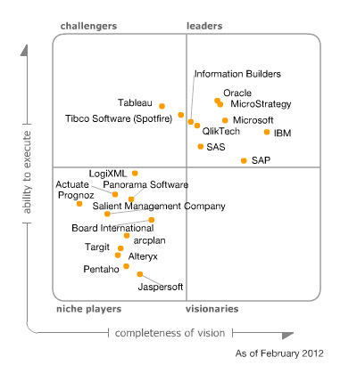
Gartner Magic Quadrant for Business Intelligence Platforms
BI Platform Decision Makers:
IT — 38.9%
Business user — 20.8%
Blended business and IT responsibilities — 40.3%

Slide 16
SAS Fraud Management - End-To-End Value
Data Management
Extraction and Manipulation of Data
Data Quality
Data preparation, summarization and exploration
Analytics
Modeling
Ad Hoc Query & Reporting
Diagnostic Analytics
Optimization to provide alternative scenarios
Detection
Continuous Monitoring
Alert Generation Process
Real-time Decisioning
Balance between risk and reward
Alert Management
Social Network Investigation
Alert Disposition
Case Management Integration
Case Investigation
Workflow & Doc Management
Intelligent Data Repository
Continuous Analytic Improvement
Dashboards & Reporting
Stream It - Score It - Store It
Typical operational lifecycle for advanced analytics: Analytics, Scoring, Monitoring
Notes:
SAS provides an end-to-end technology infrastructure for detecting, preventing and managing financial crimes across various business lines. This framework includes components for detection, alert and case management, along with category-specific workflow, content management and advanced analytics.
The long-term goal of is to establish a framework for enterprise-wide
deployment of resources, including both material and human assets. This
framework should make it possible to:
• Gather and cross-match relevant data from all product lines, organizational
units and geographic regions of your organization.
• Analyze this data to “connect the dots” and spot large-scale fraud attacks early in
their life cycle.
• Plan and execute focused countermeasures to combat large-scale attacks.
There are two key business drivers that are causing organizations to give serious attention to an enterprise-wide strategy. These are:
• Increased effectiveness. The ability to look at the issues holistically across the
enterprise and identify large-scale threats early in their development,
and mount effective countermeasures while there is still time for them to have maximum impact.
• Increased efficiency. The ability to leverage investments in data, tools and
personnel in an economic environment where every organization and function is being asked to “do more with less.”
Advanced analytics, configurability, data management and reporting/dashboards are its key differentiators.

Slide 17
Privacy by Design
A Framework for Ethics & Analyics
Proactive
Respect for Users
Life Cycle Protection
Visibility / Transparency
Positive Sum
Embedded
By Default
Ann Cavoukian, https://privacybydesign.ca/
Page 17
March 9, 2015

Slide 18
Privacy by Design
A Framework for Ethics & Analyics
Proactive, not Reactive—Preventative, not Remedial
Privacy as the Default Setting
Privacy Embedded into Design
Full Functionality—Positive-Sum, not Zero-Sum
End-to-End Security – Full Lifecycle Prevention
Visibility & Transparency – For Users and Providers
Respect for User Privacy – For All Stakeholders
Page 18
March 9, 2015

