Slide 1
Chapter 4 MODEL COMPONENT
Decision Support Systems
For Business Intelligence

Slide 2
Figure 4.1: Process of Modeling

Slide 3
Figure 4.2: A Model Airplane

Slide 4
Table 4.1: Dimensionality of Models
Representation
Time Dimension
Linearity of the Relationship
Deterministic vs. Stochastic
Descriptive vs. Normative
Causality vs. Correlation
Methodology Dimension

Slide 5
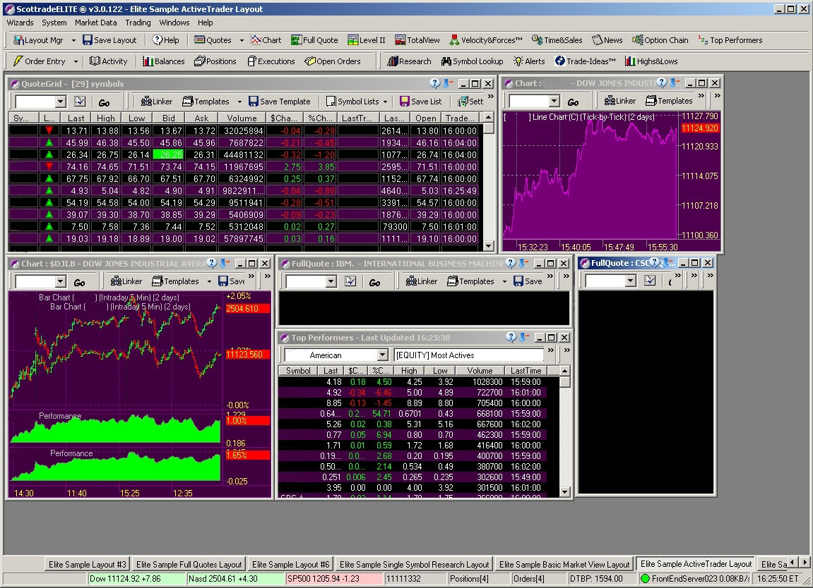
Figure 4.3: Screenshot from Scottrade’s Advanced Trading System Software

Slide 6
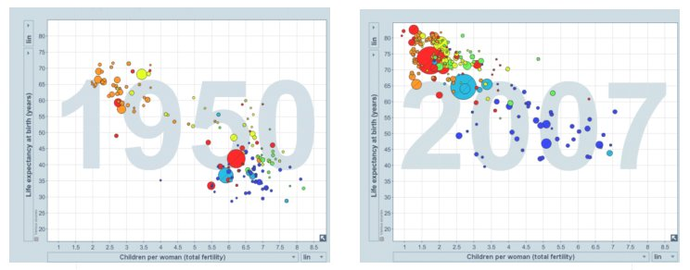
Figure 4.4: Looking at Intervals of Time for Patterns

Slide 7
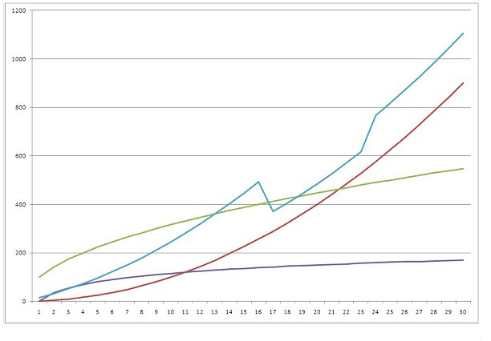
Figure 4.5: Nonlinear Relationships

Slide 8
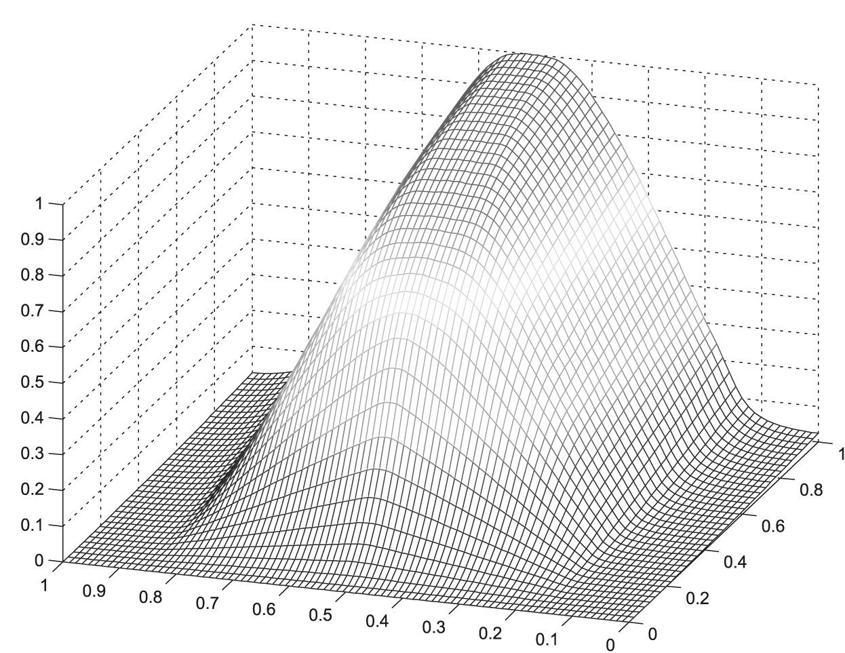
Figure 4.6: Nonlinear Higher Dimension Relationship

Slide 9
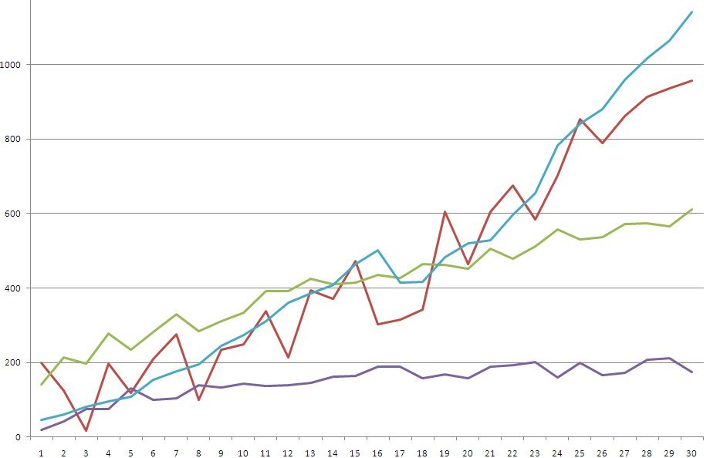
Figure 4.7: Nonlinearity with Randomness

Slide 10
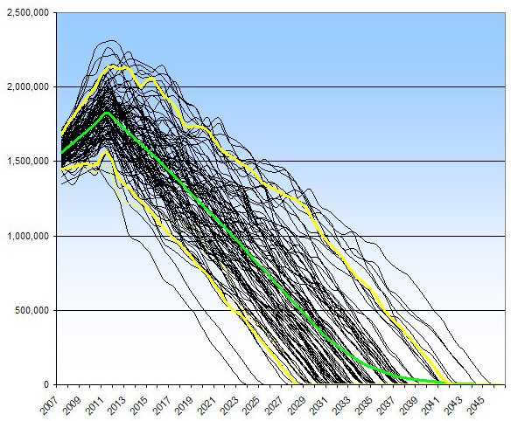
Figure 4.8: Results of a Monte Carlo Analysis

Slide 11
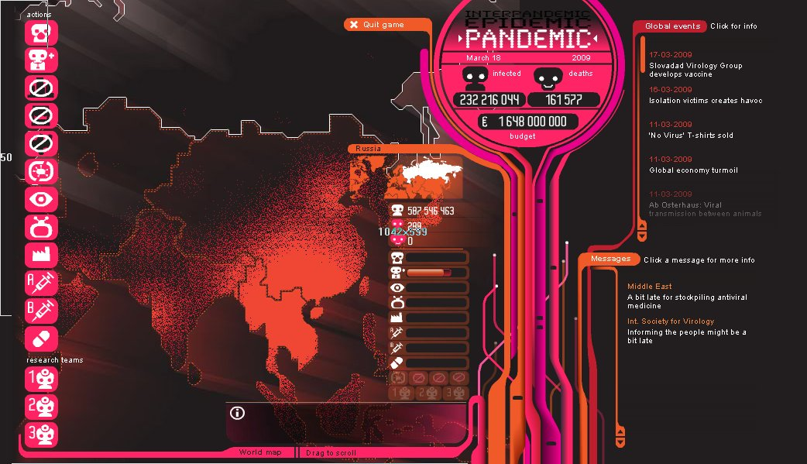
Figure 4.9: Simulation with Animaion

Slide 12
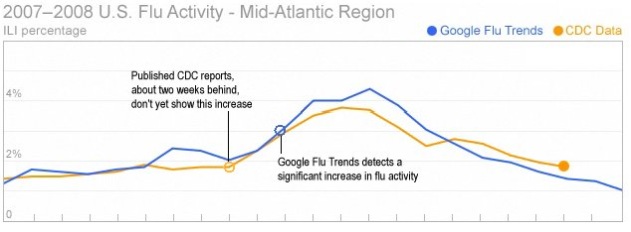
Figure 4.10: Google Results

Slide 13
Table 4.2: Data-Mining Goals
Classifications
Clusters
Regressions
Sequences
Forecasting

Slide 14
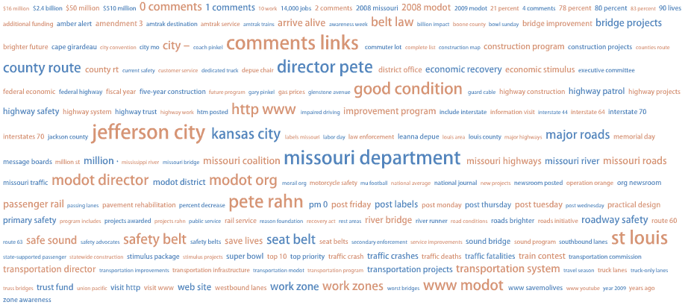
Figure 4.11: Word Cloud Analysis of a Blog

Slide 15
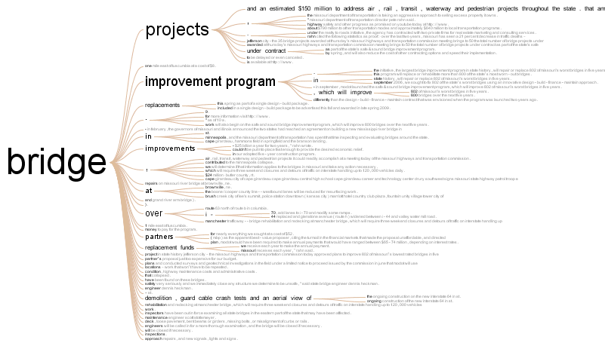
Figure 4.12: Word Tree of a Blog

Slide 16
Figure 4.13: DSSAgent Screen

Slide 17
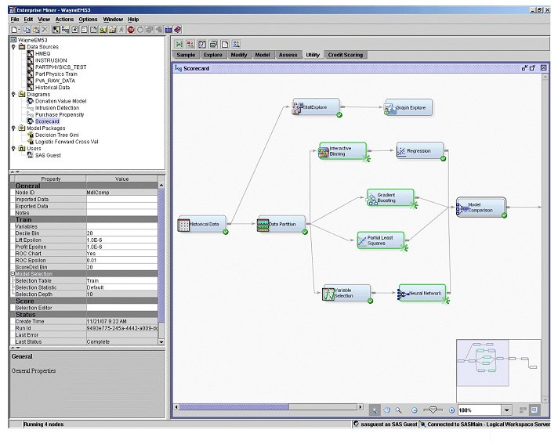
Figure 4.14: Simple Model Selection

Slide 18
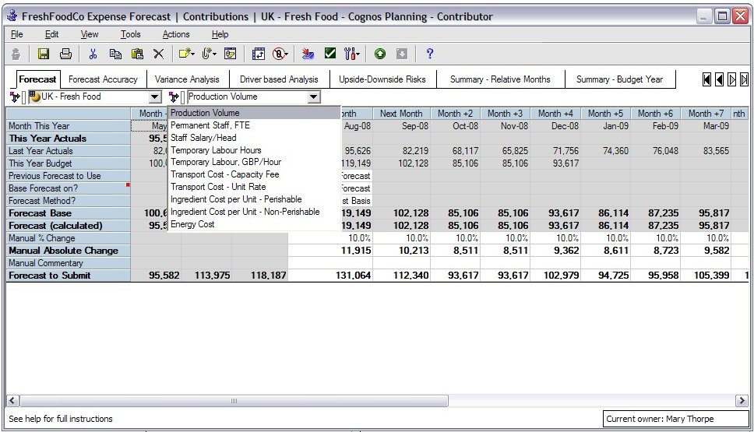
Figure 4.15: Simple Manipulation of a Model

Slide 19
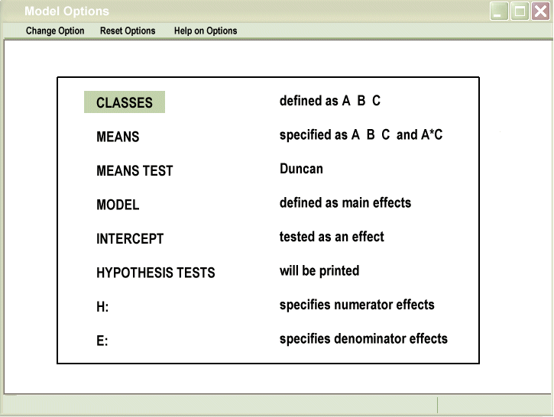
Figure 4.16: Model Option Selection

Slide 20
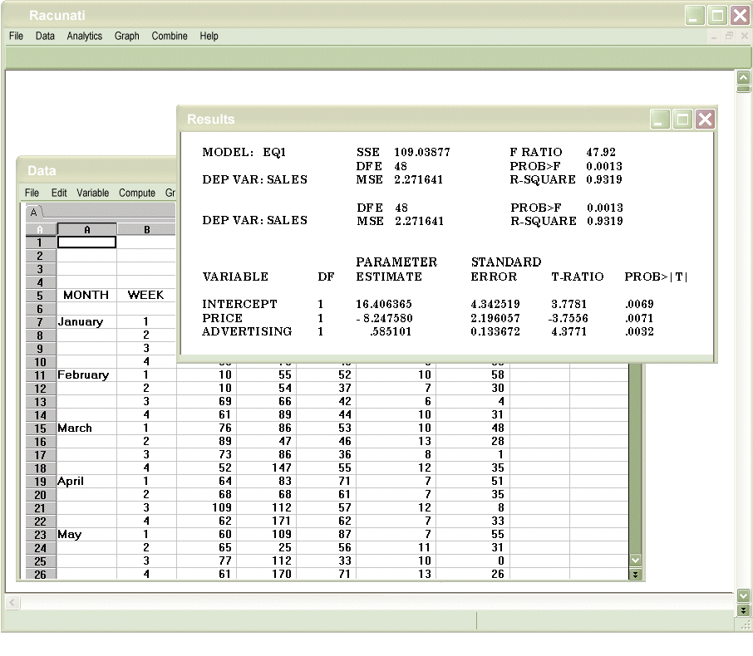
Figure 4.17: Traditional Results Format

Slide 21
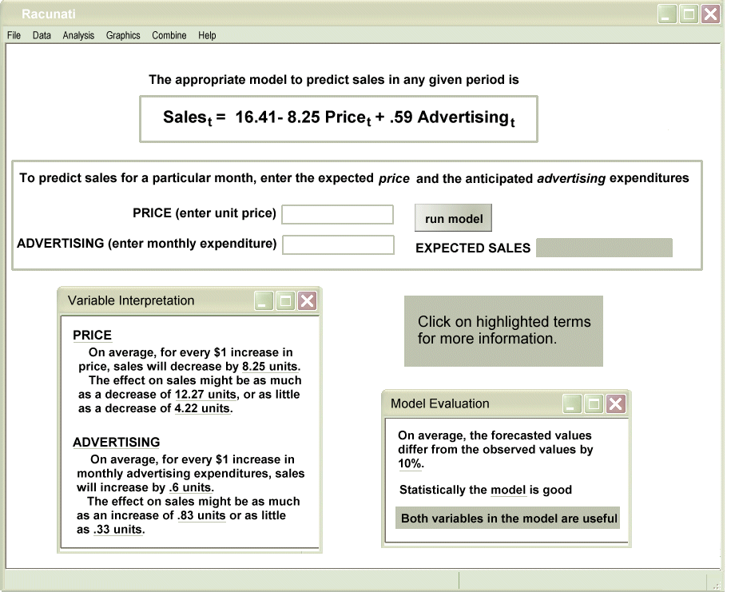
Figure 4.18: Results with Decision Support

Slide 22
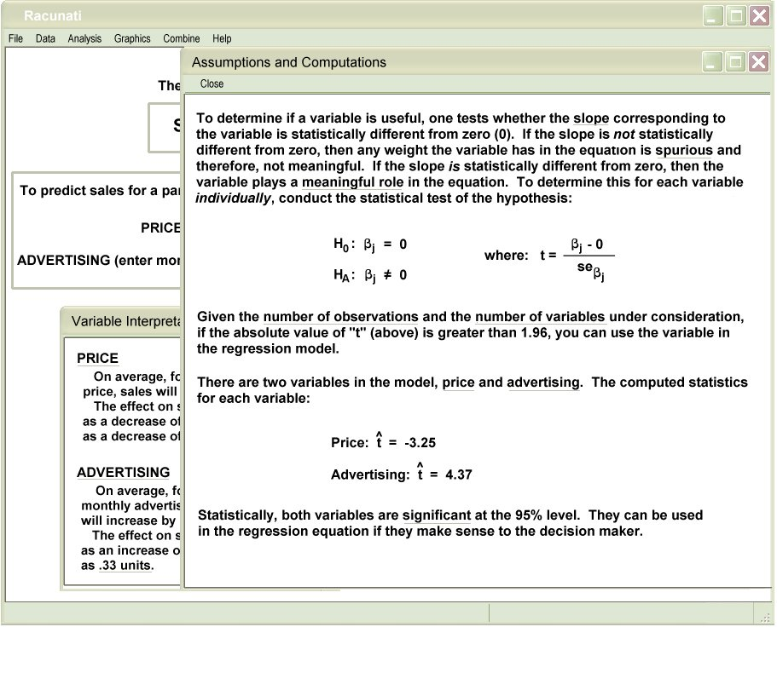
Figure 4.19: Detailed Model Support

Slide 23
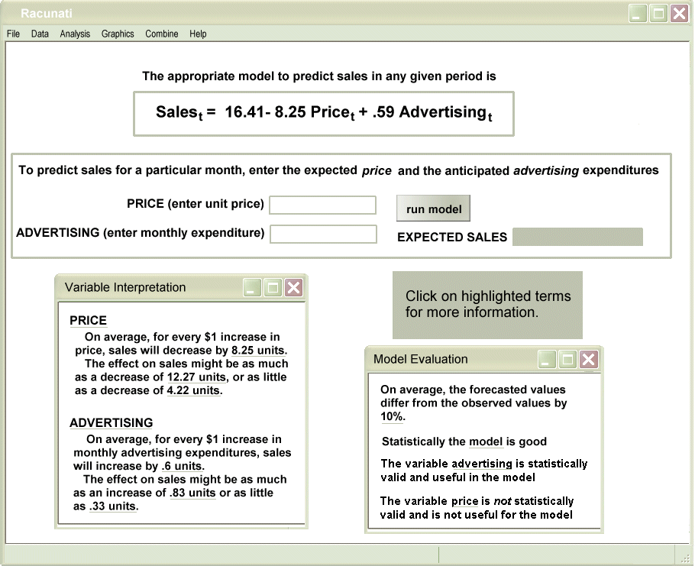
Figure 4.20: Passive Warning of Model Problems

Slide 24
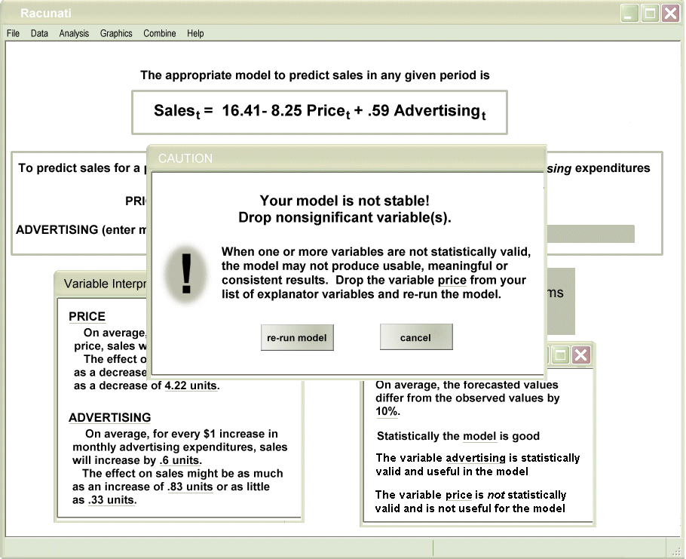
Figure 4.21: Active Warning of Model Problems

Slide 25
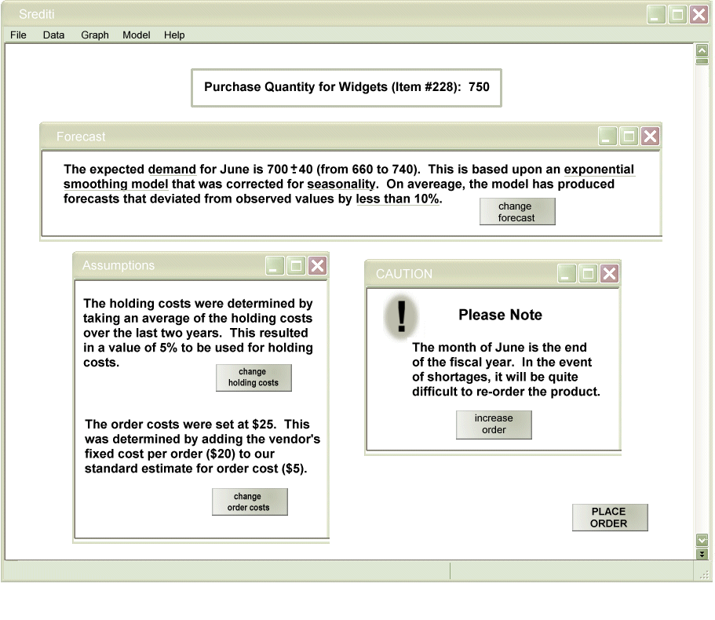
Figure 4.22: Integration of Models

Slide 26
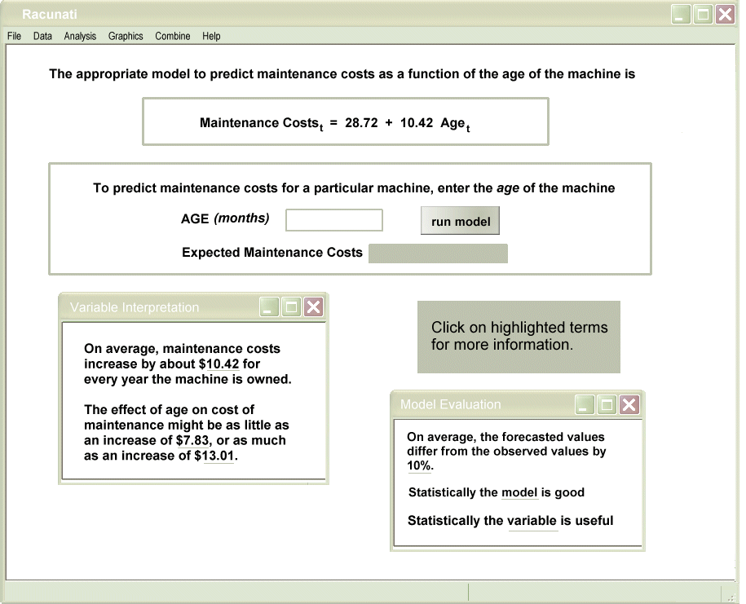
Figure 4.23: Modeling Results with Some Interpretative Support

Slide 27
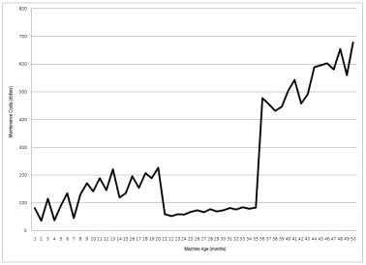
Figure 4.24: Plot of Maintenance Data

Slide 28
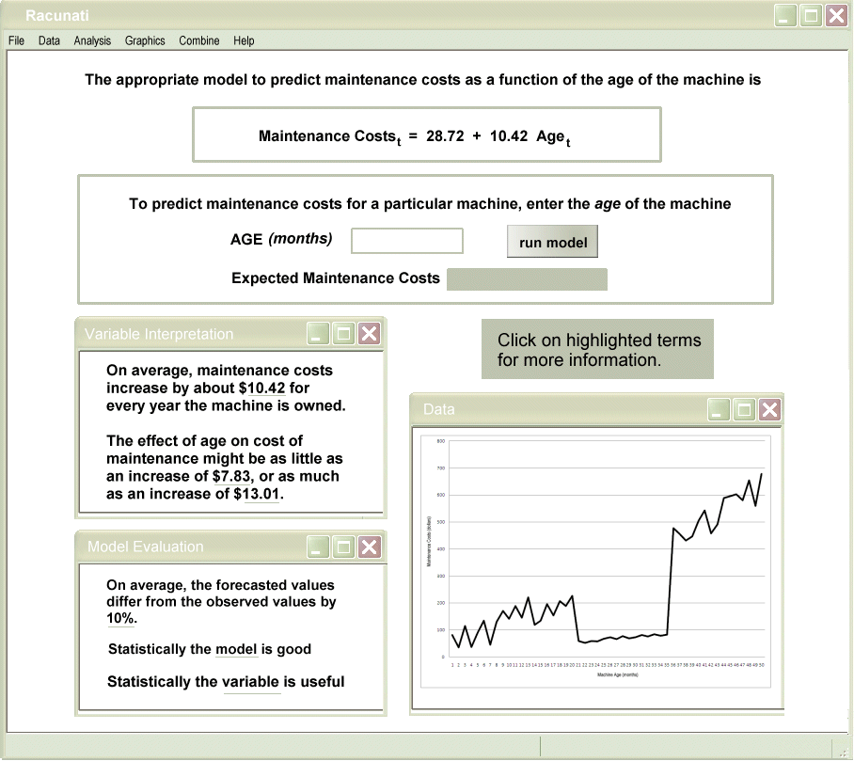
Figure 4.25: Model Results with Better Interpretative Support

Slide 29
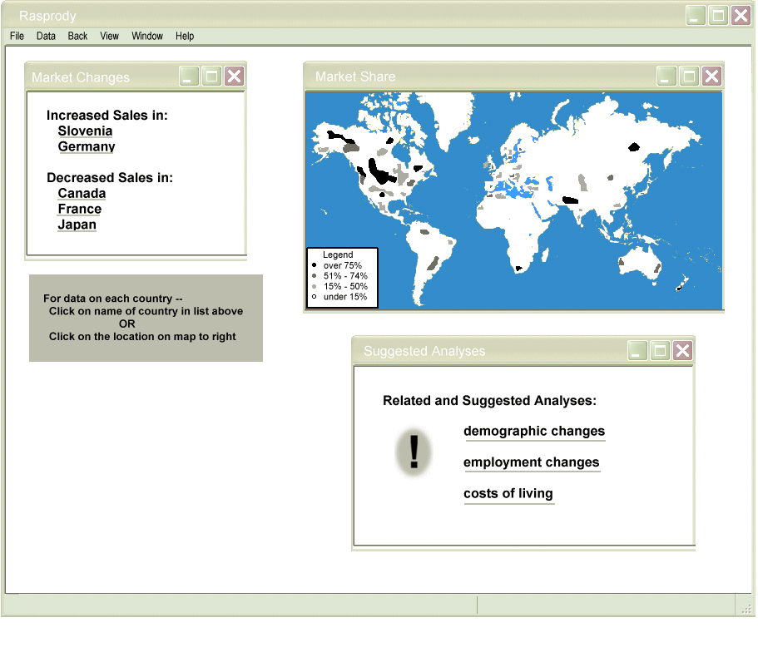
Figure 4.26: Passive Prompting for Further Analysis

Slide 30
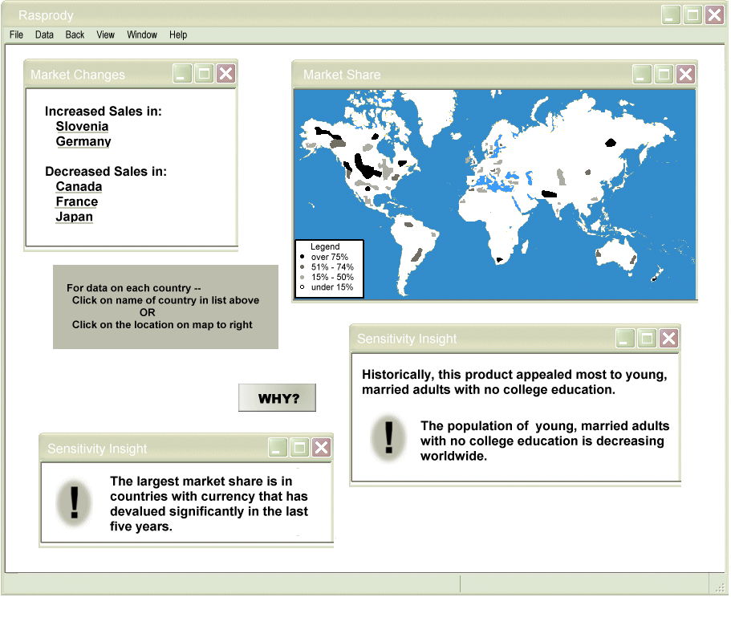
Figure 4.27: Active Prompting for Further Analyses

Slide 31
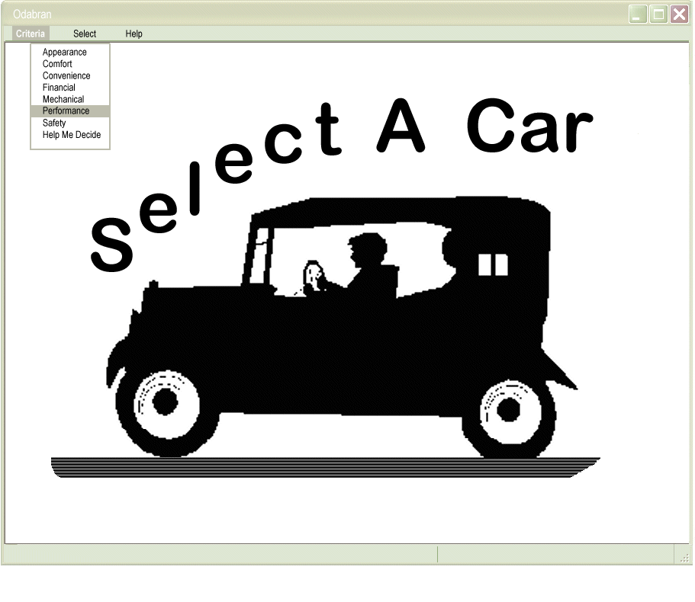
Figure 4.28: Assistance for Defining Criteria

Slide 32
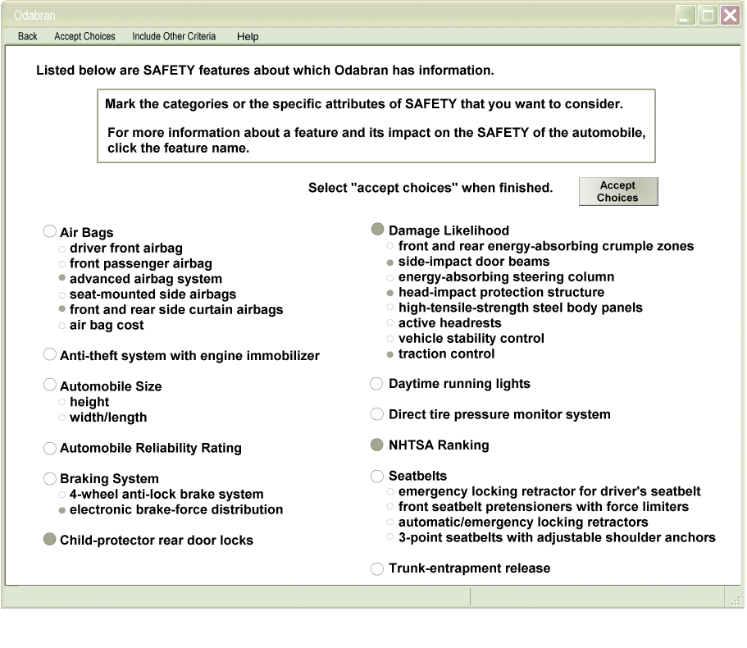
Figure 4.29: Finer Detailed Definition of Criteria

Slide 33
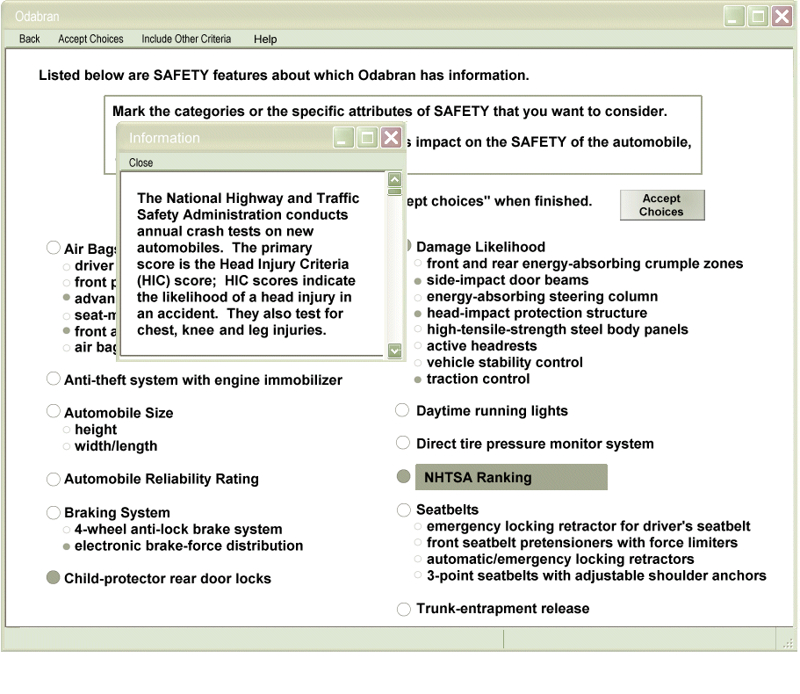
Figure 4.30: Content-Dependent Assistance of Criteria Selection

Slide 34
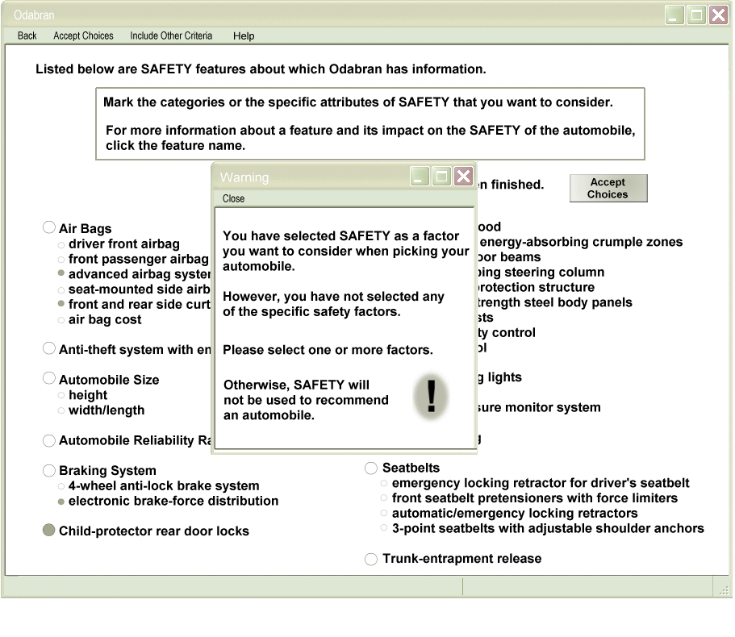
Figure 4.31: Support for Criteria Definition

Slide 35
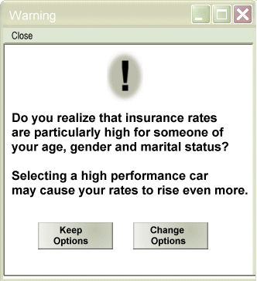
Figure 4.32: Intelligent Support in a DSS

Slide 36
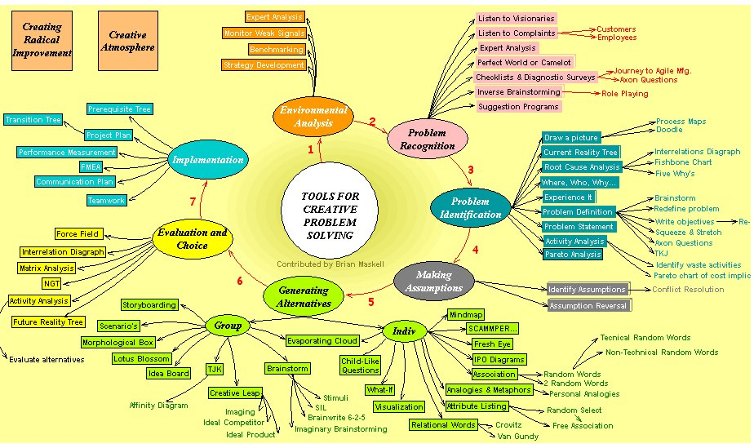
Figure 4.33: Brainstorming Support Tools

Slide 37
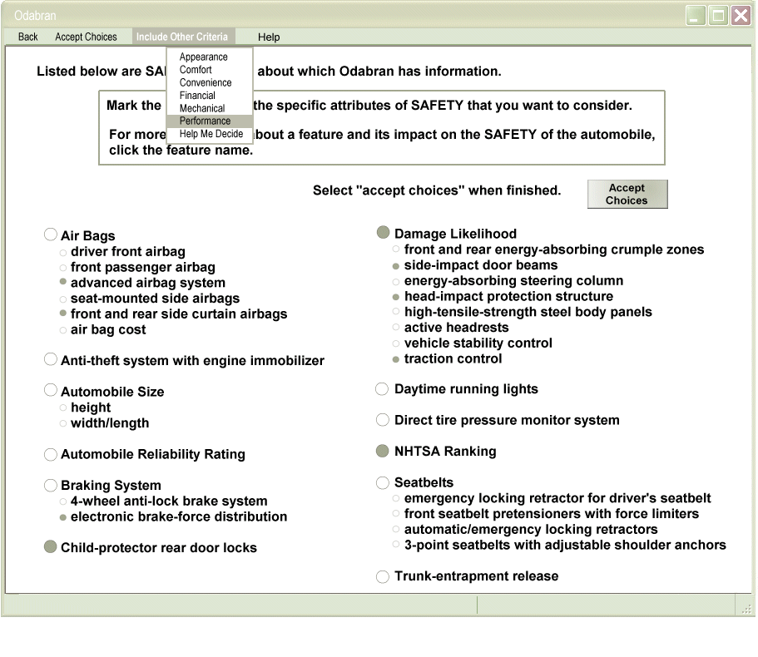
Figure 4.34: Support for Multi Criterion Choices

Slide 38
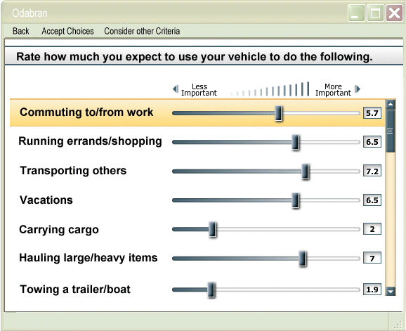
Figure 4.35: Specifying Criteria

Slide 39
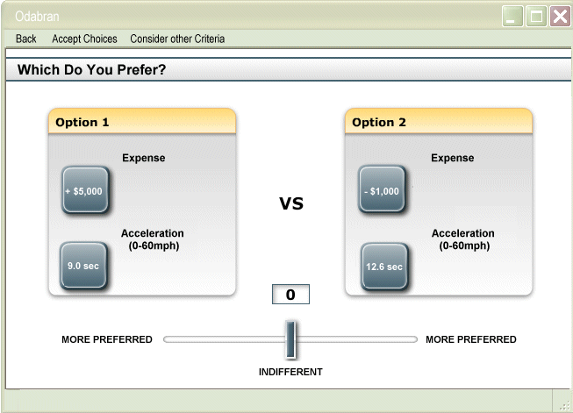
Figure 4.36: Results from Analysis

Slide 40
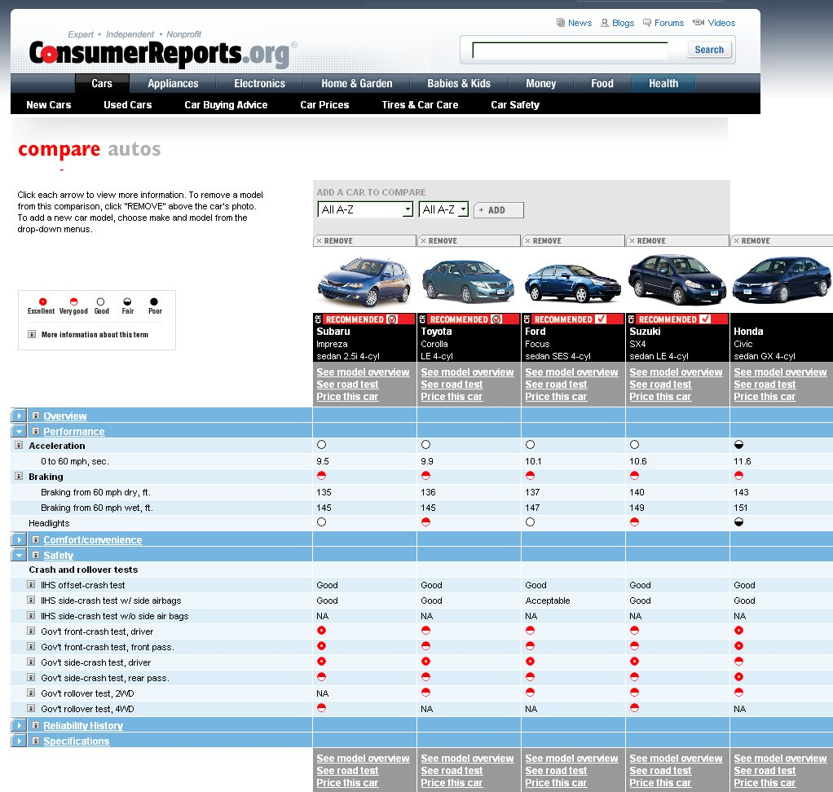
Figure 4.37: Consumer Reports Data could be Accessed from a DSS

Slide 41
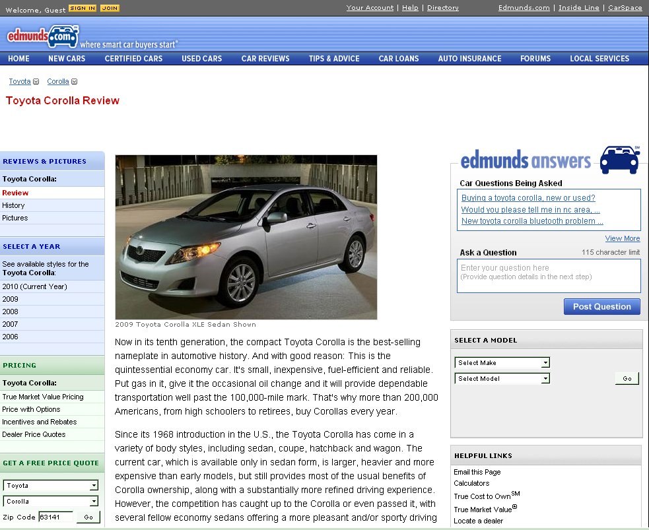
Figure 4.38: Edmund’s Car Review

Slide 42
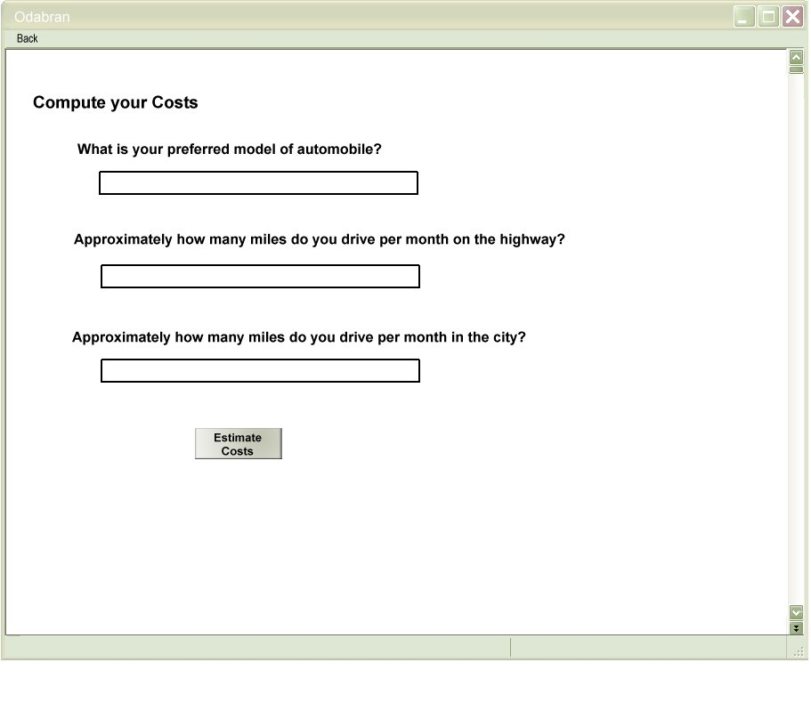
Figure 4.39: Queries Designed to Help User Better Understand Choices

Slide 43
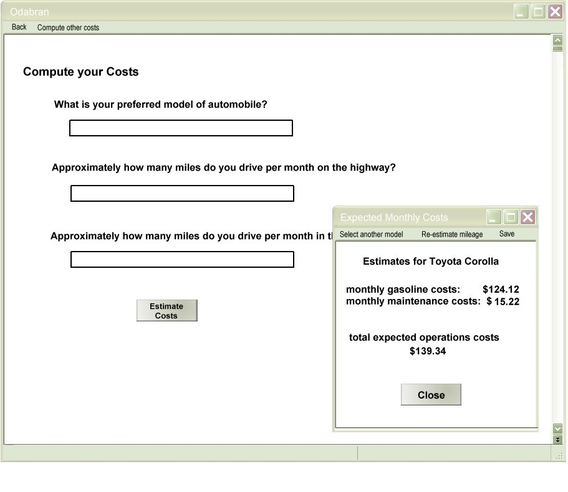
Figure 4.40: Decision Support Results

Slide 44
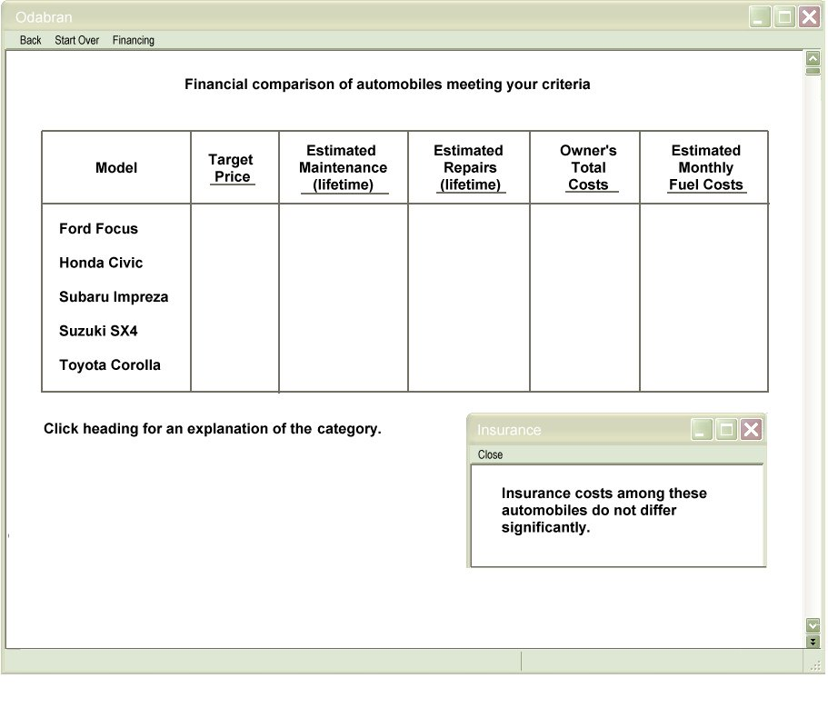
Figure 4.41: Historical Information to Facilitate Support

Slide 45
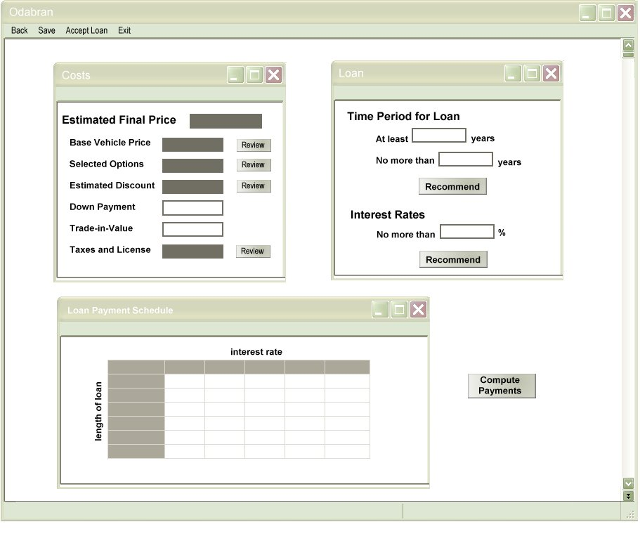
Figure 4.42: Support for Users Exploring Assumptions

