Slide 1
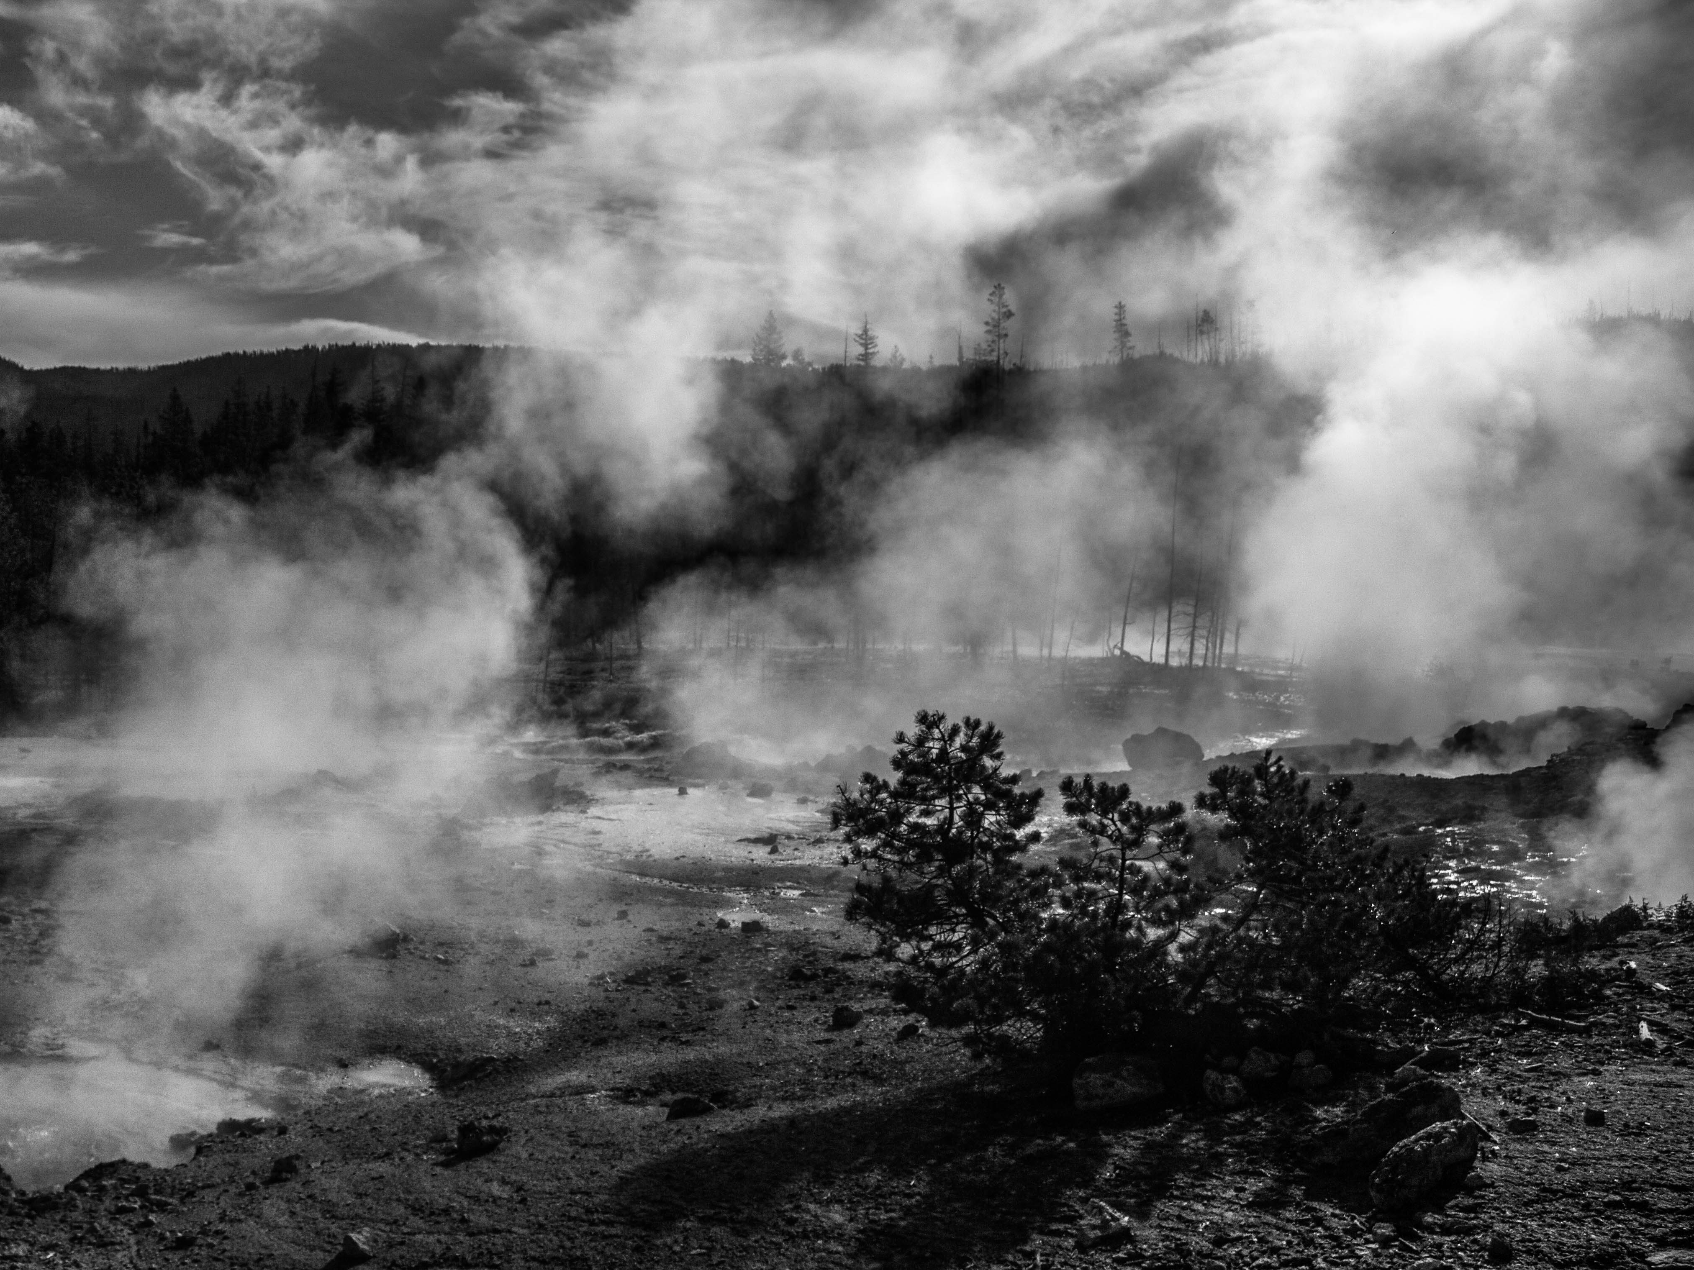
The microbial origin and evolution of life on Earth
Astrobiology and Life Beyond Earth
University of Missouri, St. Louis
April 9, 2016
Rachel J. Whitaker
Department of Microbiology
University of Illinois Urbana-Champaign
Notes:
What are the universal properties of life that we should look for elsewhere?
In what ways should it look like us?

Slide 2
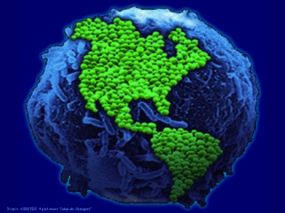
Earth is a microbial world

Slide 3
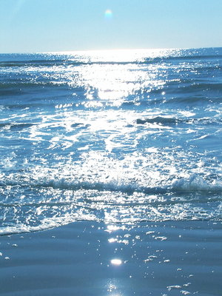
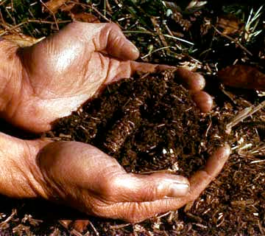
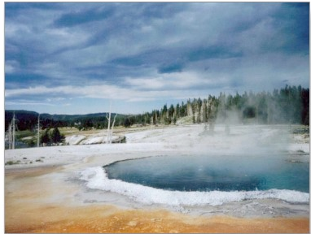
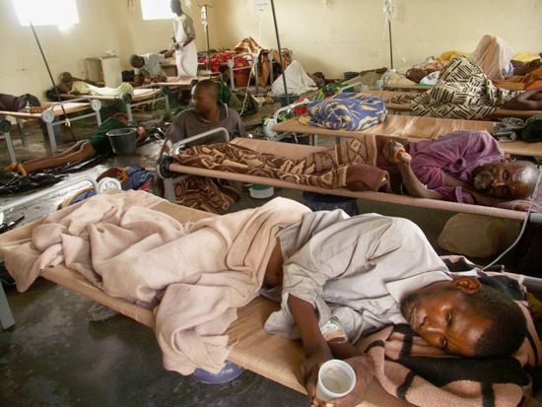
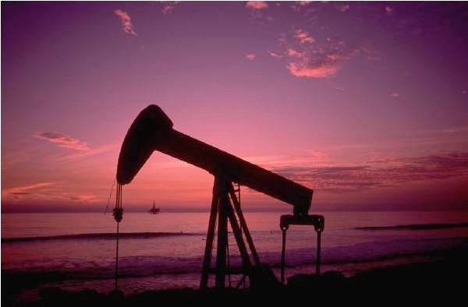
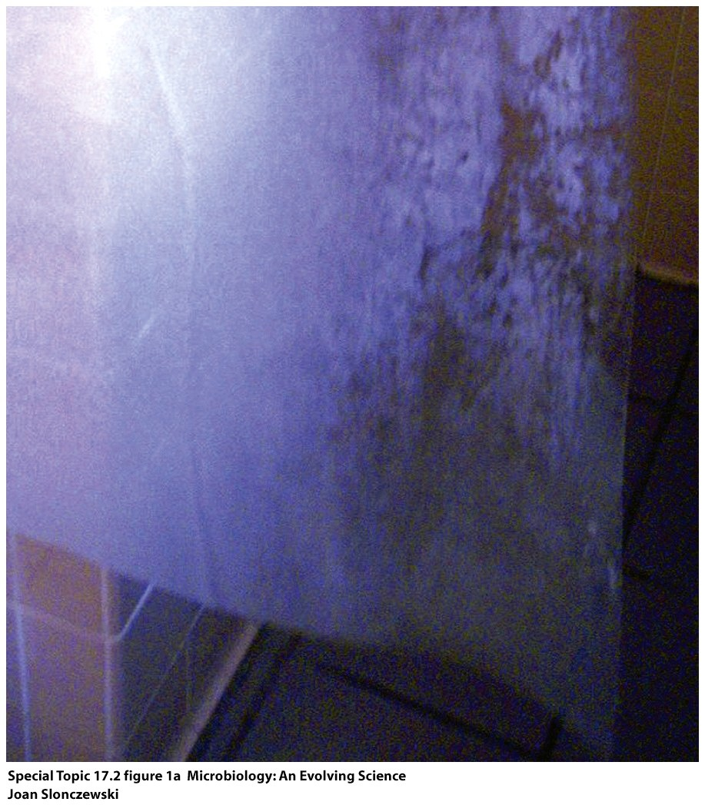
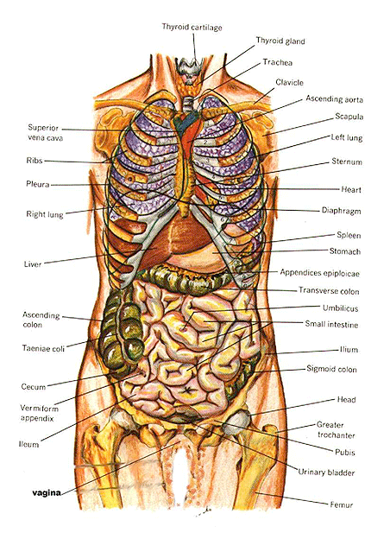
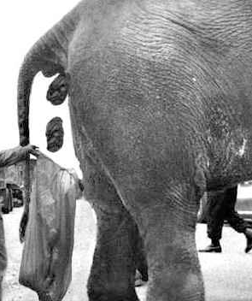
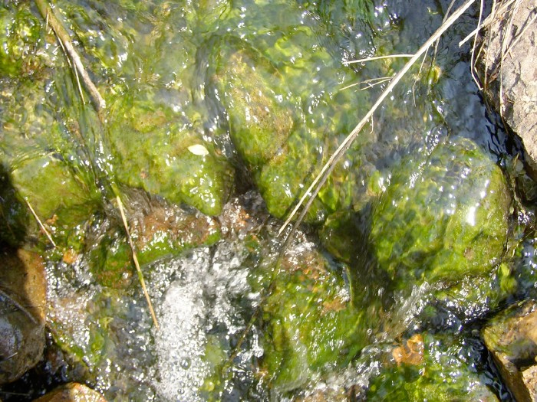

Slide 4
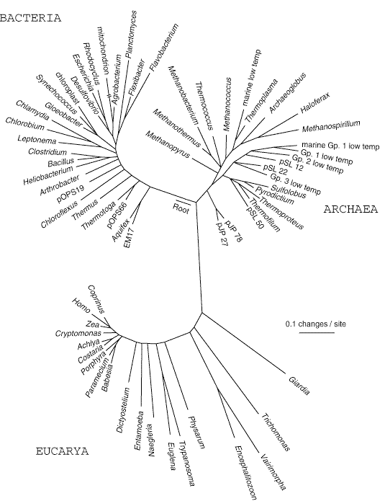
You are here
Pace, Science 1997

Slide 5
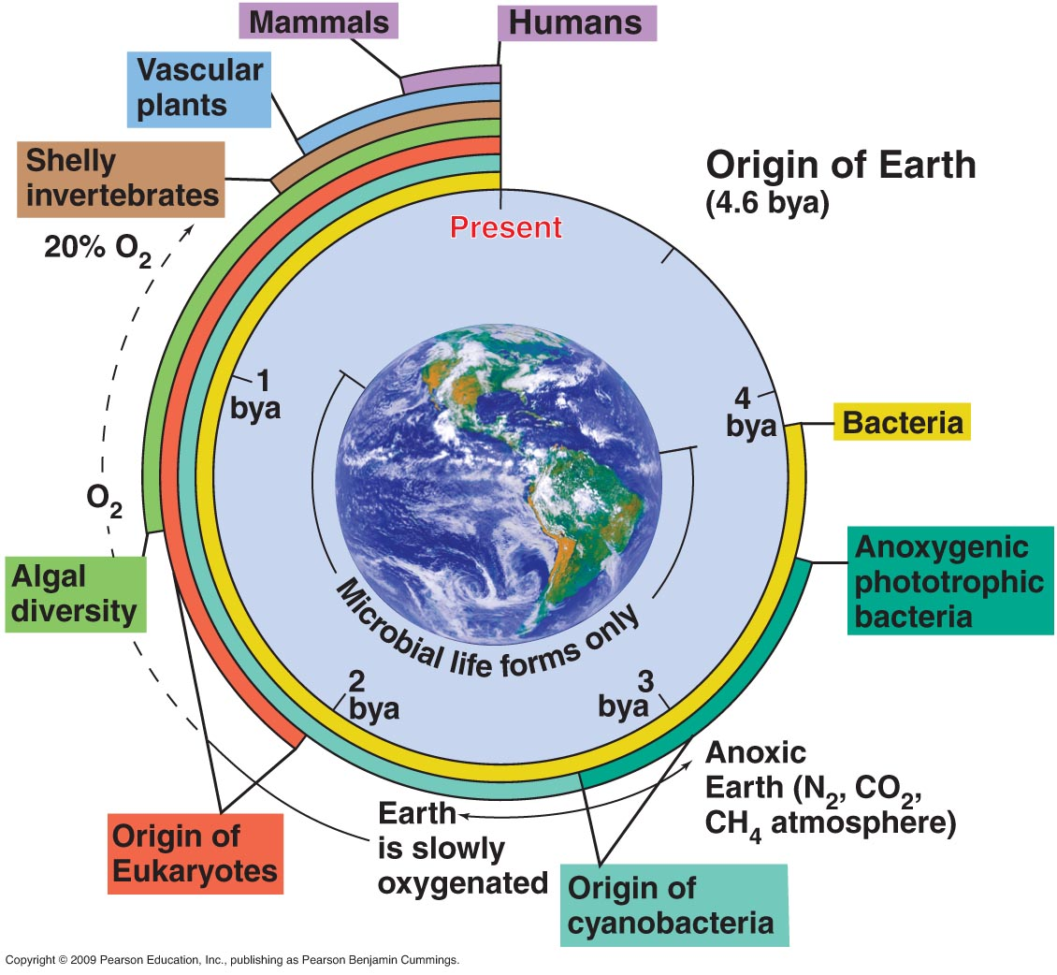
Archaea
From: Brock: Biology of Microorganisms

Slide 6
Archaea
From: Brock: Biology of Microorganisms

Slide 7
Archaea
From: Brock: Biology of Microorganisms

Slide 8
The greatest pollution event
Archaea
From: Brock: Biology of Microorganisms

Slide 9
Archaea
From: Brock: Biology of Microorganisms

Slide 10
Archaea
From: Brock: Biology of Microorganisms

Slide 11
Highly reduced/no oxygen
Archaea
Chemotrophic primary productivity without light
From: Brock: Biology of Microorganisms

Slide 12
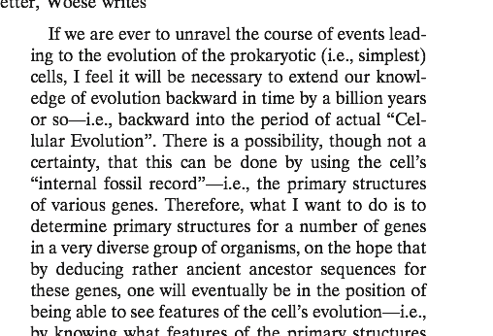
Insight: Carl R. Woese to Francis Crick 1969
Mapping the tree of life

Slide 13
Molecular fossils

Slide 14
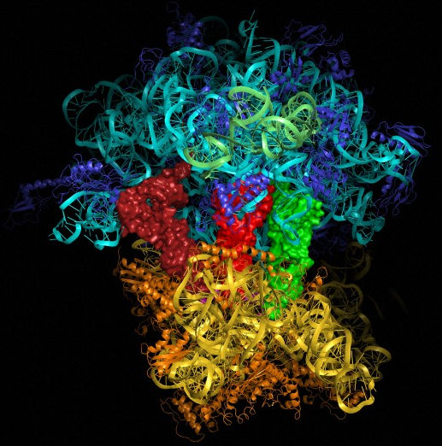
23S rRNA
16S/18S rRNA
The Ribosome
Notes:
tRNA in the APE sites. Anticodon loops are buried in small subunit as are the nascent protein being formed.

Slide 15
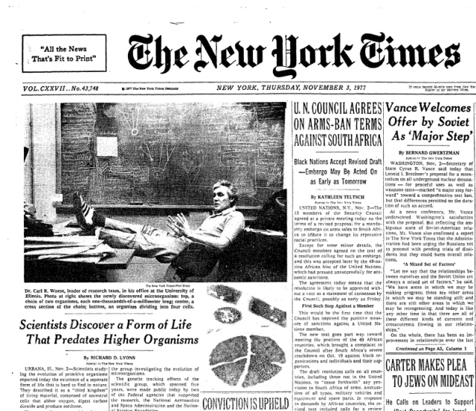

Slide 16
What did cellular life look like in the beginning?
Woese, C R, and G E Fox. “Phylogenetic Structure of the Prokaryotic Domain: The Primary Kingdoms.” Proceedings of the National Academy of Sciences of the United States of America 74, no. 11 (November 1977): 5088–90.
Notes:
TWO direction …

Slide 17
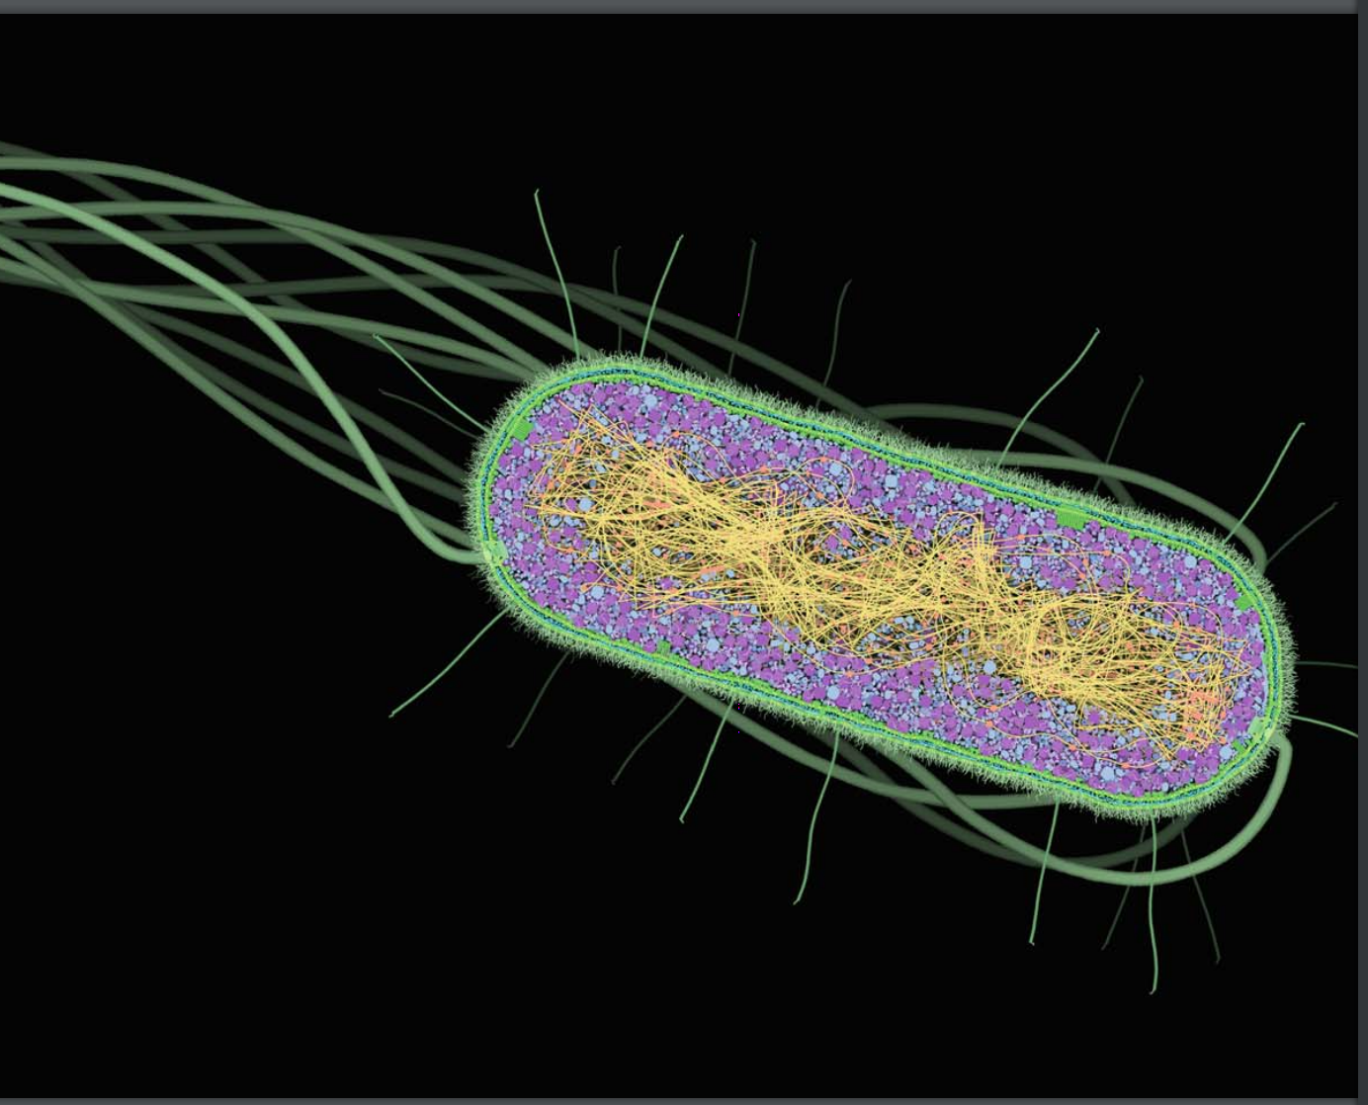
Microbial Cell
The Microbial Cell
Chromosome
Motility and environment interaction
DNA Chromosome
Transcription
DNA->RNA
Ribosome
Translation
RNA-> protein
Membrane
Identify components shared by different groups and map onto the tree of life

Slide 18
What Components Are Universal?
Map characters onto the tree of life to see what was shared by the common ancestors

Slide 19
Metabolism

Slide 20
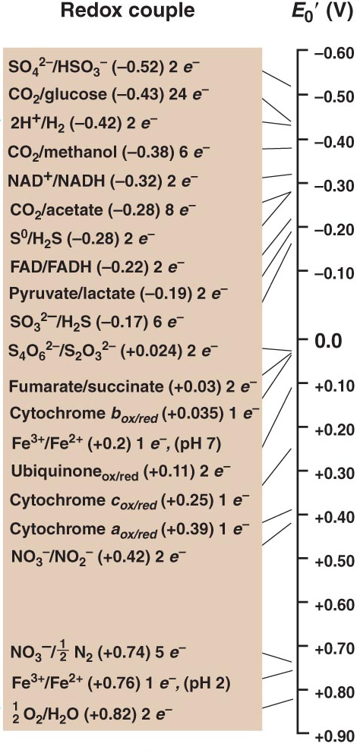
Most negative strongest donors
Methanosarcina mazei
Desulfovibrio vulgaris
Shewanella oneidensis
You
Most positive strongest acceptors
Notes:
You know about his because you do it all day every day. Glycolysis and the crebs cycle result in NADH that donates electrons to oxygen you breathe and give you energy. Microbes are the masters of this with extreme diversity and flexibility. They an eat go through glycolysis and use breathe iron or Nitrate or sulfate instead of oxygen. They can eat hydrogen and breathe nitrate or sulfate,
There are some of these combinations that only life has figured out how make run under these conditions and others occur chemically.

Slide 21
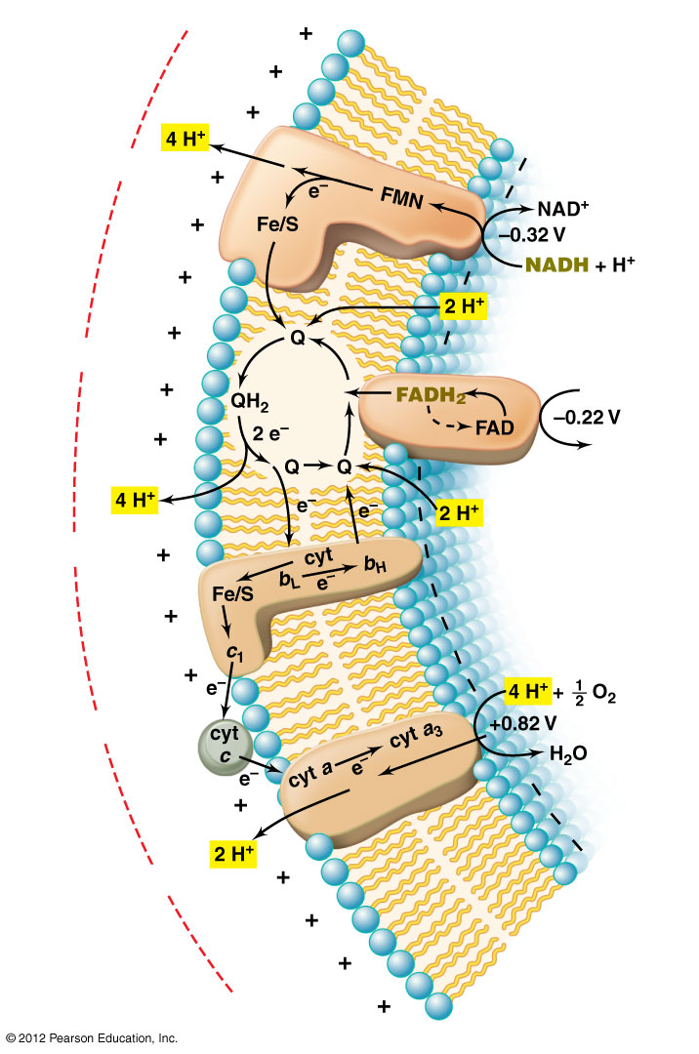
Electron transport chain makes a gradient
ATPase harvests the gradient
E₀′(V)
−0.22
0.0
ENVIRONMENT
+0.1
CYTOPLASM
+0.36
+0.39
E₀′(V)
Notes:
Figure 4.19 Generation of the proton motive force during aerobic respiration.
Minute 5:20

Slide 22
ATP synthase
Flexible enzyme for energy generation depends upon a cell

Slide 23
The Cell
Threshold
Lipid Bilayer And Cell Membrane

Slide 24
Genome Replication And Chromosome Structure
DNA polymerases, initiation of replication

Slide 25
Transcription
Other DNA-dependent RNA polymerase subunits and initiation complexes

Slide 26
Transcription
2 subunits of DNA-dependent RNA polymerase subunits

Slide 27
Translation
rRNA, tRNAs, elongation factors, tRNA charging enzymes, most (but not all) ribosomal proteins

Slide 28
Microbial Cell
The Microbial Cell
Chromosome
Motility and environment interaction
DNA Chromosome
Transcription
DNA->RNA
Ribosome
Translation
RNA-> protein
Membrane
ATPase and some way to make proton motive force
What if we just can’t recognize cellular functions that are shared?

Slide 29
Changes in Evolutionary Mode
fossils
3.5 bya
4.5 bya
Before 3.5 billion there must have been a difference in either tempo or mode
Woese, C. R., and G. E. Fox. “The Concept of Cellular Evolution.” Journal of Molecular Evolution 10, no. 1 (September 20, 1977).
Notes:
Compartmentalization vs well mixed. Limited diffusion in chemical terms

Slide 30
The Progenote
Vertical decent
Progenote
Communal evolution
Woese, C. R., and G. E. Fox. “The Concept of Cellular Evolution.” Journal of Molecular Evolution 10, no. 1 (September 20, 1977).
Notes:
When, why and how did life evolve from a communal form to one of vertical decent? How did so much diversity arise so fast?

Slide 31
Evolutionary Mode Of The Progenote
The progenote was in the process of evolving the relationship between genotype and phenotype.
No individual cells, instead “supermolecular aggregates” with communal sharing of genetic material.
Sharing mode allowed a faster tempo and resulted in the rapid generation of complex molecular machines for translation and energy production.
Communal mode is ongoing if limited by vertical predominance of vertical evolution.
Woese, C. R., and G. E. Fox. “The Concept of Cellular Evolution.” Journal of Molecular Evolution 10, no. 1 (September 20, 1977).
Vetsigian, K., C. R. Woese, and N. Goldenfeld. “Collective Evolution and the Genetic Code.” Proc Natl Acad Sci USA 103 (2006): 10696–701.
Notes:
Apply the universal rules of evolution whether they be to genes or to biopolymers
What needs explaining is not why the major cell designs are so similar, but why they are so different.
This apparent contradiction can be resolved by assuming that the highly diverse cell designs that exist today are the result of a common evolution in which each of them began under (significantly)
different starting conditions.

Slide 32
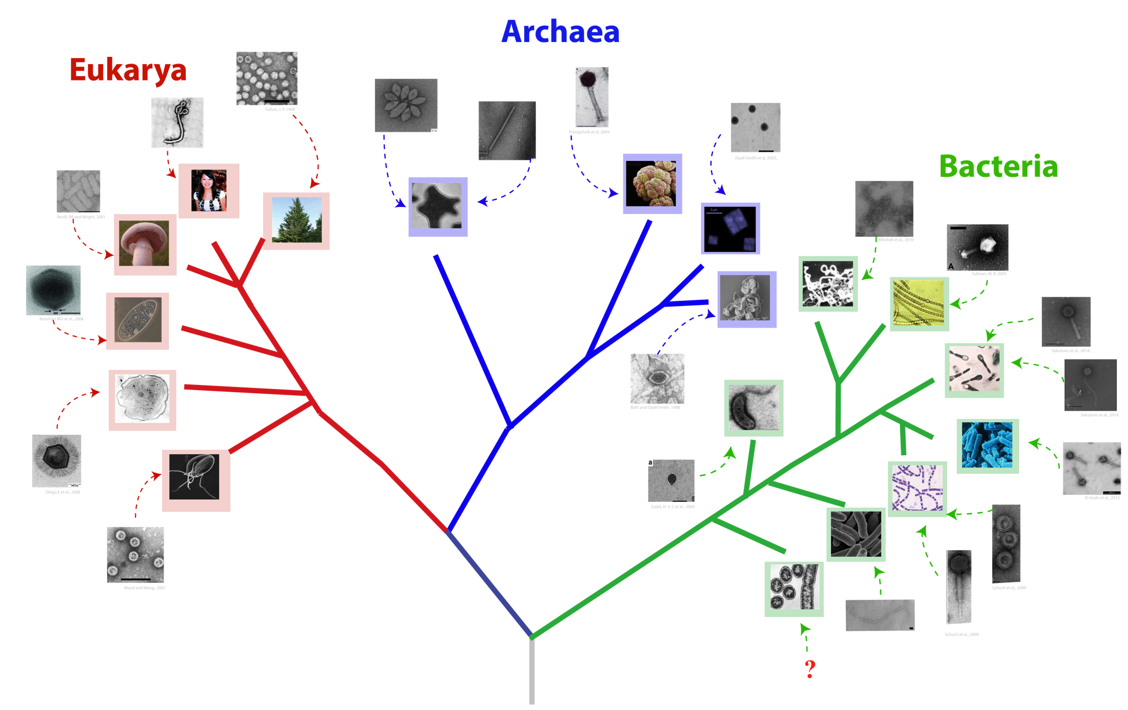
Viruses …the next frontier
Archaea
Eucarya
Bacteria
We need a new lens for population genetic analysis

Slide 33
Whitaker Lab Members
David Krause
Maria Bautista
Dr. Changyi Zhang
Whitney England
Samantha Dewerff
Elizabeth Rowland
Ted Kim
Yueheng Zhou
Jesse Black
Former Lab Members
Dr. Rika Anderson
Dr. Nicholas Youngblut
Dr. Nicole L. Held
Dr. Hinsby Cadillo-Quiroz
Dr. Kim Milferstedt
Dr. Angela Kouris
Michael Reno
Collaborators
Mark Young (Montana State)
Kate Campbell (USGS)
D. Kirk Nordstrom (USGS)

