Slide 1
James R. Moody & Associates
Missouri State University
March 2015

Slide 2
Outside Data Sources
A presentation entitled “The New Normal” by Tom Gillaspy and Tom Stinson.
Missouri Population Pyramid slides from the State Demographer site, Missouri Division of Budget & Planning, Office of Administration.

Slide 3
Presentation OVerview
Missouri General Revenue Overview 101
Education Funding History
The New Normal (Our Aging Population)
Legislative Changes To Our Tax System

Slide 4
COMPOSITION OF MISSOURI STATE BUDGET—ALL FUNDS

Slide 5
Revenue Sources for General Revenue
Source | Percentage
Individual Income Tax | 67.5%
Sales Tax | 21.5%
Corporate Income/Franchise Tax | 5%
Insurance Premium Tax | 2.3%
All Other | 1.1%

Slide 6
Sales Tax HAS Been Flat For
Over A Decade

Slide 7
Missouri Income From
Capital Gains and Dividends
Combined Over $12 Billion

Slide 8
Where Does General Revenue Spending Go?
Elementary and Secondary Education | $2.94 billion
Higher Education | $856 million
Corrections & Public Safety | $687 million
Human Services | $2.46 billion
Judiciary | $200 million
General Assembly & Elected Officials | $90 million
All Other | $1.05 billion

Slide 9
K-12 Foundation Formula Funding Since FY 2008
Fiscal Year | Foundation Formula Appropriation
2008 | $2,869,115,911
2009 | $2,983,312.456
2010 | $3,004,388,410
2011 | $3,004,388,410
2012 | $3,004,388,410
2013 | $3,009,388,411
2014 | $3,075,271,737
2015 ** | $3,175,471,739 **(Governor’s Released Amount)

Slide 10
Higher Education Funding Since FY 1996

Slide 11
February 2015
Fiscal Year To Date
General Revenue Receipts
Category | YTD Gross % Increase | YTD Net % Increase (net of refunds)
Individual Income Tax | +6.3% | +5.0%
Sales Tax | +3.3% | +4.9%
Corporate Income/Franchise | +4.0% | +11.8%
Insurance Premium Tax | +3.3% | +10.1%
Total Year To Date |  | +4.9%
Source: FY 2015 Consolidated Revenue Report |  | Net Increases are net of refunds paid

Slide 12
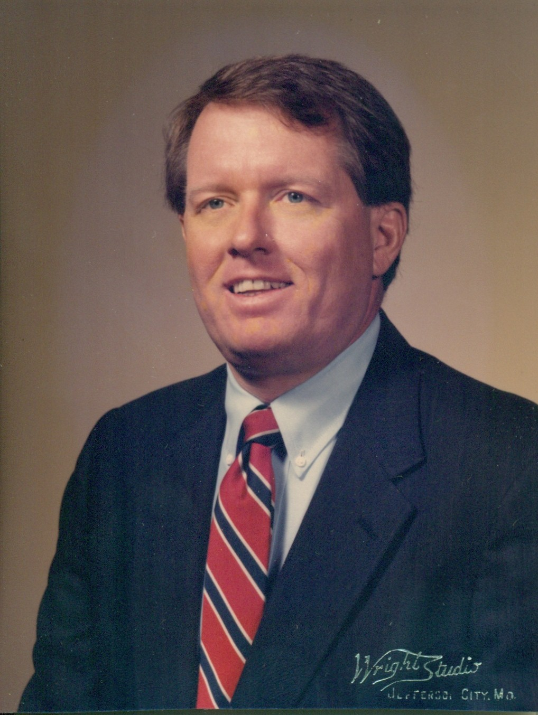

Our Aging Population
Circa 1989
Circa 2010

Slide 13
Tom Gillaspy on AGing
“There is a new theory in demography. It’s one of those math theories. Most of us age one year every twelve months. It’s a pretty regular process….We are poised on a very enormous retirement boom unprecedented in history…We are an aging society. This has never happened before.”
                -Tom Gillaspy,
                retired Minnesota demographer

Slide 14
The “New Normal” Probably Means
Creative destruction/disruptive innovation will change the way we deliver services
Chronic government deficits & cuts in service
Worries about how to pay for past promises
A whole new set of opportunities

Slide 15
The Number Of Americans Turning Age 65 Increased Sharply (25%) In 2012
Millions
US Census Bureau ACS; The New Normal

Slide 16
From 2015 To 2025 The US Will See Large Increases Age 60s And 70s
Change in Thousands
Census Bureau projections, 2012; The New Normal

Slide 17
By 2020 The United States Will Have More People 65+ Than School Age
Census Bureau forecast 2012; The New Normal
Notes:
17
17

Slide 18
US Labor Force Growth Will Be At Record Low Levels By The End Of This Decade
US Bureau of Labor Statistics forecast; The New Normal

Slide 19
Missouri’s Aging Population
Between 1950 and 2000, the 65 and over population grew by 85% to 755 thousand persons.
Between 2000 and 2030, this group is expected to grow an additional 87%, to 1.4 million persons.
In 1950 in Missouri those over 85 represented one-half of one percent of the population—21,000.
By 2000 those over 85 were 99,000 persons—or 2% of the population.
By 2030, those over 85 will represent 2.5% of the population, or 176,000 persons.

Slide 20
What Is A Reason The Average Population Age is Increasing?
Fewer Teen Pregnacies
Lower Overall Fertility Rate
Teen births in 2013 (274,641) were the lowest number ever reported in the U.S.
The new record-low teen birthrate (26.6 births per 1,000 women age 15-19) is a 10% decline since 2012 and a 57% decline since 1991.
The birthrate for younger adult women fell to a record low of 81.2 births per 1,000 women aged 20-24.
The general fertility rate slipped to a record low of 62.9 births per 1,000 women aged 15-44.

Slide 21
The Rectangular AGe Pyramid in 2030
Year 2030 –By Age Group | Percent of Population | Cumulative Percent of Population
Preschool | 6% | 6%
Kindergarten to 8th | 11% | 17%
Grades 9 to 12 | 5% | 22%
Age 18 to 24 | 9% | 31%
Age 25 to 44 | 25% | 56%
Age 44 to 64 | 22% | 78%
Over 65 | 21% | 100%
Source: Missouri Office of Administration |  | Cumulative is rounded to equal 100%

Slide 22
Missouri Population
Population Pyramid of Missouri – 1900
Male and Female Combined
Percent of Total Population
Missouri Office of Administration, Division of Budget & Planning

Slide 23
Missouri Population
Population Pyramid of Missouri – 2000
Male
Female
Percent of Total Population
Missouri Office of Administration, Division of Budget & Planning

Slide 24
Missouri Population
Population Pyramid of Missouri – 2030
Male
Female
Percent of Total Population
Missouri Office of Administration, Division of Budget & Planning

Slide 25
State Taxes Paid by a Married Couple Before and After Retirement
(Minnesota example; The New Normal)
Income |  | Income Tax |  | Sales Tax | Total | Change |  | Pct
Working
$35,000 |  |  | $1,236 | $782 | $2,018
$65,000 |  |  | $3,387 | $1,295 | $4,682
Retired @ 70 %
$25,000 |  |  | $0 | $559 | $559 | -$1,459 | -72%
$45,000 |  |  | $1,091 | $896 | $1,987 | -$2,695 | -58%

Slide 26
Seemed Like A Good Idea At the Time!!!
Missouri’s experience will be worse than the Minnesota example.
House Bill 444, passed in 2007, phased out the state income tax on Social Security and public pensions over a six year period, ending in 2012.
As our population ages, Missouri will receive virtually no individual income taxes from elders receiving Social Security and public pension.
These same elders in their later years also purchase less goods that are subject to state sales tax.
The population pyramids spell bad news for future state budgets.

Slide 27
MO Healthnet Enrollees & Expenditures
MO HealthNet
SFY-2012
In SFY-2012, seniors and
persons with disabilities
comprised more than 27%
of enrollees, however, they
accounted for nearly 66%
of MO HealthNet expenditures.
($3,398.0 M)
Number of People SFY-2012
(Average Monthly)
($1,218.6 M)
($626.1 M)
Total (893,976)
Missouri Department of Social Services

Slide 28
What Services Does Medicaid Pay For Because Medicare Does Not?
Skilled Nursing Care
In-Home Services, such as personal hygiene care, homemaker and chore services
These services are normally required for elderly people.

Slide 29
Tax Cut Legislation
Senate Bill 509 will be implemented over roughly the next 15 years.
It’s implementation will coincide with enormous demographic shifts due to the aging population.
With SB 509 in place, revenue growth would be very limited.
The aging of the population will make revenue growth even more limited.

Slide 30
The Basics of Senate Bill 509
SB 509 includes a 25% reduction in “business income” in five increments of 5%, based upon triggers of $150 million “growth”.
“Business income” includes partnerships, S-Corps and LLCs.
SB 509 has no change in the tax rate for C-Corps.
SB 509 reduces the top individual income tax rate from 6% to 5.5%, with five increments of .1% each. This reduction is also based upon a trigger of $150 million “growth”.
The first reduction is deferred until 2017.

Slide 31
Senate Bill 509
Senate Bill 509 has been characterized by its proponents as “broad-based tax relief”.
Is that true? Let’s examine which income segments pay the most income tax in Missouri.

Slide 32
Who Pays The Missouri
Individual Income Tax?
Missouri AGI | % of Taxpayers | % of Taxes Paid
Under $50,000 | 66.8% | 13.6%
$50,000 to $75,000 | 14.2% | 13.9%
$75,000 to $100,000 | 8.6% | 13.2%
Over $100,000 | 11.5% | 59.1%

Slide 33
The Way SB 509 Would Really Work
Drafters of the bill suggest that taxes would only be cut after growth.
This theory ignores the probability that growth would occur after a drop in revenue from previous downturns in revenue, such as after recent recessions.
Missouri’s revenues at one time were fairly stable. Not any more. Assuming that FY 2014 revenues are negative, Missouri would have had five negative fiscal years in the last thirteen fiscal years.

Slide 34
Recent Net
General Revenue Growth

Slide 35
Revenues Since FY 1998 If SB 509 Were In Effect

Slide 36
Summary
The future of Missouri government will not be pretty.
Missouri has adopted ill-advised new tax policies at a particularly bad time.
The aging population will mean fewer workers paying taxes to support government programs.
Governmental revenue growth will be very limited, which means government will shrink.
The aging population will require more governmental services at a time when government spending will shrink.

Slide 37
Questions
????????????

